Slide 1

Public Awareness Plans

Slide 2
§192.615 Emergency Plans
“Establish an educational program to enable customers and the general public to recognize and report a gas emergency to the appropriate officials.”

Slide 3
Public Awareness
Became public awareness section of code as §192.616
Damage Prevention Programs for Excavators §192.614 (c)
Emergency Plans for Emergency Responders §192.615
Subpart O – Integrity Management

Slide 4
PSIA of 2002
Use of a one-call notification system prior to excavation and other damage prevention activities;
Possible hazards associated with unintended releases from the pipeline facility;
Physical indications that such a release may have occurred;
Steps that should be taken for public safety in the event of a pipeline release; and
Procedures to report such an event.

Slide 5
§192.616 Public Awareness
Final Rule Published May 19, 2005
Effective date of Final Rule June 20, 2005
Requires operators to follow the guidance of API RP 1162, “Public Awareness Programs”, First Edition, December 2003
  Defines baseline and supplemental (enhanced) programs
Modified in 2007 to relax requirements for operators of master meter systems and certain petroleum gas systems

Slide 6
§192.616 Public Awareness
Requires operators to follow the guidance of API RP 1162, “Public Awareness Programs”, First Edition, December 2003
PHMSA has decided not to incorporate the Second Edition of API RP 1162 at this time

Slide 7
Public Awareness Applicability
Applies to:
  Interstate and intrastate natural gas and hazardous liquid transmission pipelines
  Natural gas distribution companies
  Gathering pipeline operators

Slide 8
Public Awareness Audience
Defined in Section 2.8 of RP 1162
Audience includes:
  Affected public – residents along or near the pipeline
  Emergency Officials
  Local Public Officials
  Excavators/Contractors
  Land Developers
  One-Call Centers

Slide 9
Public Awareness Message
Major Requirements for communications
  Message type
    Specific for each target audience
  Delivery frequency
    Appropriate for audience
  Delivery methods or media
    Delivered in an effective manner

Slide 10

Public Awareness Message

Slide 11
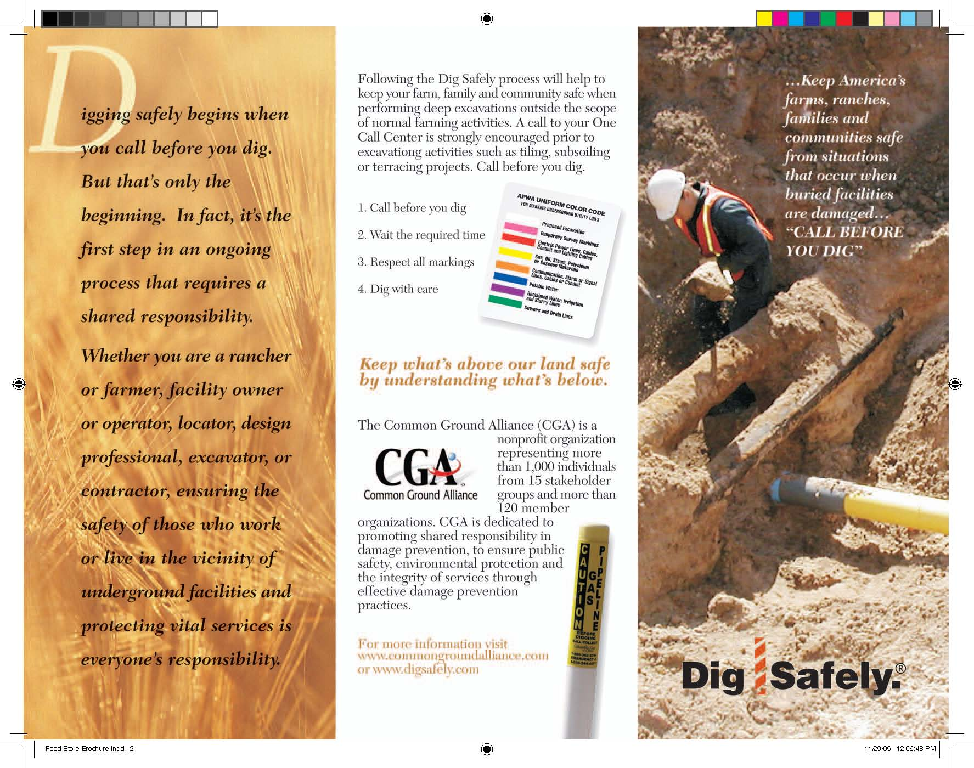

Public Awareness Message

Slide 12
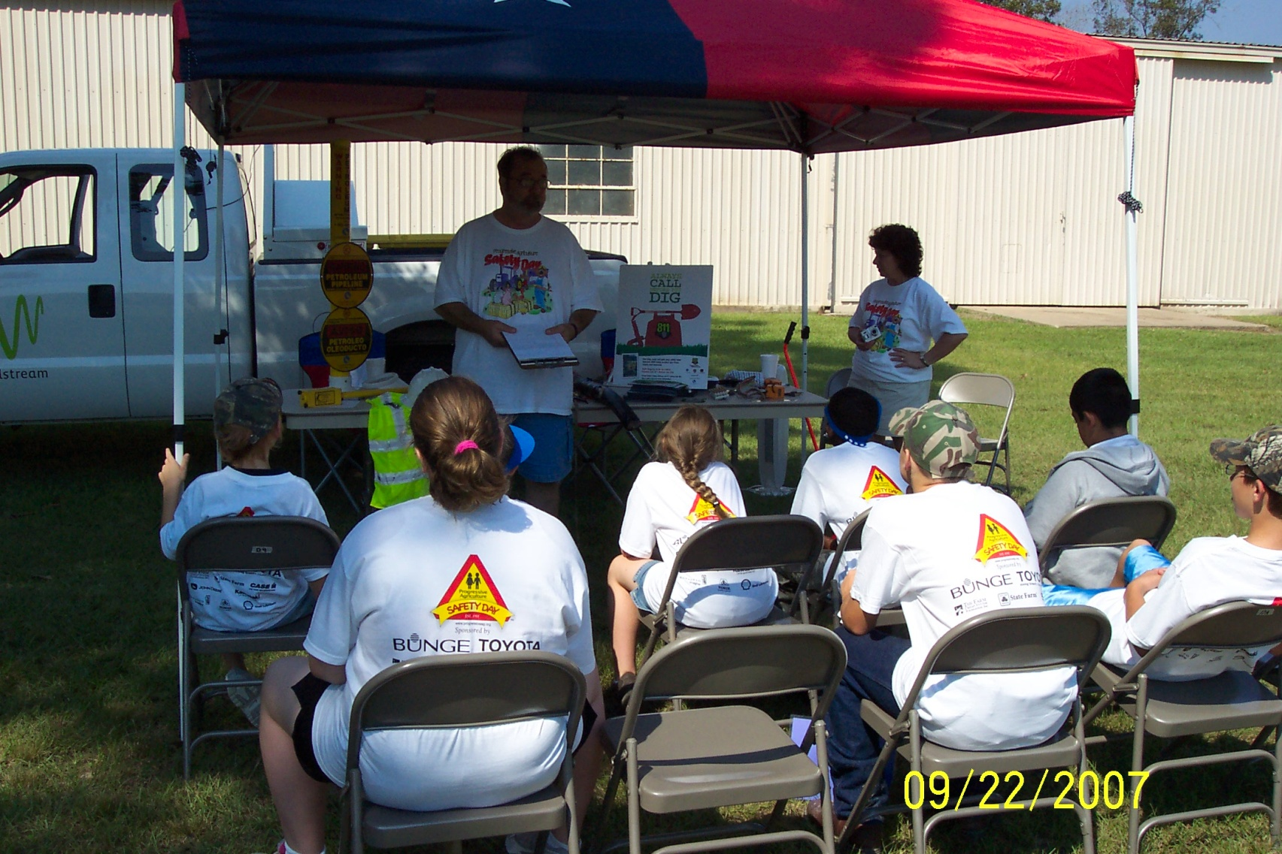
Public Awareness Message

Slide 13
Evaluating Program Effectiveness
API 1162 – Section 8 Program Evaluation
8.1 Primary purposes to:
  Assess if the current program is effective in achieving the objectives
  Provide information on implementing improvements based on the findings
Secondary purpose:
  demonstrate the status and validity of program

Slide 14
Evaluation Elements
8.2 Elements of Evaluation Plan
  Measures should reflect:
  Whether the program is being implemented as planned (the process)
  Whether the program is effective (program effectiveness)

Slide 15
Measuring Implementation
8.3 Measuring Program Implementation
  Purpose, answer two questions:
  Has the Public Awareness Program been written to address the objectives, elements, and baseline schedule in Section 2
  Has the public awareness program been implemented and documented according to the written program

Slide 16
Measuring Effectiveness
8.4 Measuring Program Effectiveness
  Assess progress on measures to see if goals were achieved:
  Is information reaching the intended stakeholder audiences
  Do the recipient audiences under stand the messages delivered
  Are the recipients motivated to respond appropriately in alignment with the information provided
  Is the implementation of the public awareness plan impacting bottom line results (reducing incidents, third party hits, etc.)

Slide 17
Measuring Effectiveness
8.4.1 Measure 1 Outreach: Percentage of Each Intended Audience Reached With Desired Messages
  Track percentage of individuals or entities reached within an intended audience (households, excavators, local government, first responders, etc.)
  Estimate the percentage of the stake holders actually reached within the target geographical region along the pipeline
  Measure will help to evaluate delivery methods

Slide 18
Measuring Effectiveness
8.4.2 Measure 2 Understandability of the Content of the Message
  Assesses the percentage of the intended stakeholder audience that understood and retained the key information in the message received
  Evaluate the effectiveness of the delivery media style and content
  Will help to assess the effectiveness of the delivery methods used

Slide 19
Measuring Effectiveness
8.4.2 Measure 2 Understandability of the Content of the Message
  Pretest materials:
  Operators should pretest their public awareness materials for their appeal and messages for their clarity, understandability and retain-ability before they are widely used
  Pretest may be performed using a small representative audience or focus group

Slide 20
Measuring Effectiveness
8.4.2 Measure 2 Understandability of the Content of the Message
  Survey target stakeholder audiences:
  Assess understandability by surveying the target stakeholder audience in the course of face-to-face contacts, telephone or written surveys
Factors to consider when designing surveys include:
  Appropriate sample size to draw general conclusions
  Questions to gauge understandability of messages and knowledge of survey respondent
  Retention of messages
  Comparison of most effective means of delivery

Slide 21
Measuring Effectiveness
8.4.3 Measure 3 Desired Behaviors by the Stakeholder Audience
  Measure of whether appropriate prevention behaviors have been learned and whether appropriate response or mitigation measures would or have taken place.
  Baseline Evaluation:
  The survey conducted to assess Measure 2 (understandability of the content of the message) should be designed to include questions that ask respondents to report on actual behaviors following incidents

Slide 22
Measuring Effectiveness
8.4.3 Measure 3 Desired Behaviors by the Stakeholder Audience
  Supplemental evaluation:
  Operators may also want to assess whether their public awareness program has successfully driven other behaviors
    Whether excavators are following through on all safe excavation practices , in addition to calling the One Call Center
    The number of notifications received from the One Call Center (was there an increase after distribution of public awareness materials)
    An assessment of first responder behaviors, response to pipeline related calls and post incident assessments, were their actions consistent with the key messages in the public awareness communications

Slide 23
Measuring Effectiveness
8.4.3 Measure 3 Desired Behaviors by the Stakeholder Audience
  Supplemental evaluation:
    Assessments of actual incidents should recognize that each response would require unique on –scene planning and response to specifics of each emergency
    Measuring the appropriateness of public stakeholder responses could include tracking whether an actual incident that affected residents was correctly identified and whether reported and personal safety actions undertaken were consistent with public awareness communications

Slide 24
Measuring Effectiveness
8.4.4 Measure 4 Achieving Bottom-Line Results
  The change in the number and consequences of third party incidents is one measure of bottom line results.
  As a baseline an operator should track the number of incidents and consequences caused by third party excavators
  The tracking of leaks caused by third party excavation should be compared to statistics of pipelines in the same sector
  Data regarding third party excavation damages should be evaluated over a relatively long period of time to determine any trends applicable to the operators public awareness program
  One other measure an operator may consider is the affected public’s perception of the safety of pipelines

Slide 25
SUMMARY OF EVALUATION PROCESS
Evaluation Approaches | Evaluation Techniques | Recommended Frequency
Self Assessment of Implementation | Internal review | Annually
Evaluation of effectiveness of program implementation: Outreach Level of knowledge Changes in behavior Bottom-line results | Survey operator-designed and conducted survey | No more than four years apart.
Implement changes to the PAP | Responsible person as designated in written PAP | As required by findings within 12 months of evaluation
Notes:
Received the message
Comprehend the message
Behavioral modification
Bottom Line Results
Damages decreased 3rd, 2nd, 1st party damages
near misses
Local Officials are they communicating with operator in the early stages of new subdivision planning?
Emergency responders post accident review are they taking appropriate steps and working with operator as partner.
Affected Public are they taking the appropriate steps during emergencies did they leave the house and call from a safe spot?

Slide 26
Evaluation Methods
Operator designed and conducted survey
Use of predesigned third party or industry association survey
Trade association survey segmented by operator, state, or other relevant means to allow operator specific results.

Slide 27
Evaluation Methods
Questionnaires distributed as an individual document or “bill stuffer.”
Personal or telephone interviews.
Interview panels comprised of a broad sample of the general public (e.g., customers, local officials, excavators, persons living near pipelines).

Slide 28
Continuous Improvement Ideas
Tracking information:
  Query data in meaningful way?
  One call tickets, particularly by caller type
  Excavators and one call tickets
  Number of hits declined?
  Calls to monitoring center

Slide 29
Continuous Improvement Ideas
Tracking information
  Repeat offenders for hits
  Repeat offenders for excavations without a valid one-call ticket
  Bad locate tickets
  Changes to mailing lists

Slide 30
Document
Document,
Document, and
Document some more

Slide 31
Document
Follow up actions to data and analysis
  Include other activities that exceed RP 1162 baseline activities such as
  Planning meetings
  Landowner contacts and meetings
  Other interactions
    Required by Emergency Planning, Damage Prevention, and Integrity Management

Slide 32
Document
Supplemental Activities or enhancements
  High Consequence areas
  Population density
  Land development activity
  Pipeline history
  Local conditions
Complete list of considerations in Section 6.2 of current RP1162

Slide 33
API RP 1162 Revisions
Focus on clarification and streamlining
PHMSA concerned with no “watering down”
Should versus May
Documentation - i.e. regular mail versus certified for some stakeholders
Frequencies – alignment between types of operators

Slide 34
Inspections
Public Awareness is part of standard and integrated inspections
Records, accuracy of mailings, and effectiveness evaluations will be reviewed

Slide 35
More Information
http://primis.phmsa.dot.gov/comm/PublicAwareness/PublicAwareness.htm
http://www.phmsa.dot.gov/pipeline/tq/regs

Slide 36
Thanks!
Questions?
Bryan.Kichler@dot.gov

