Slide 1
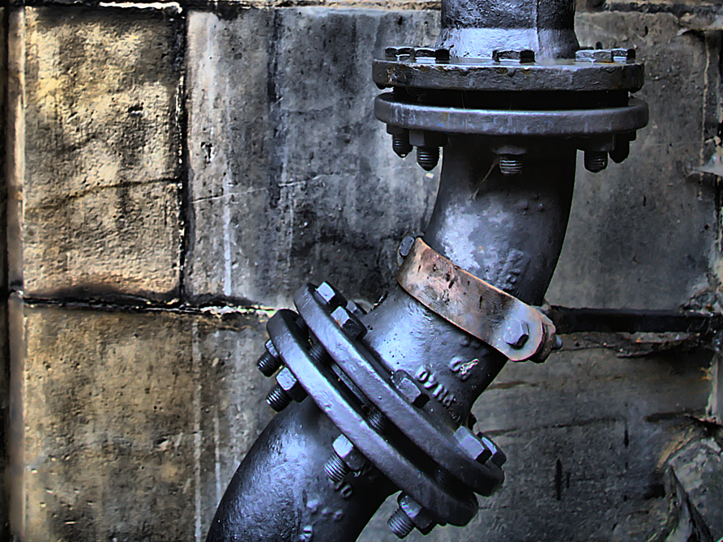
O&M and Emergency Plans Records
Nevada 2019
Bryan Kichler PHMSA TQ Bryan.Kichler@DOT.Gov

Slide 2
Subpart L - Operations
O&M and Emergency Plans
KIL-A-MOP

Slide 3
§192.603 General Provisions
  No person may operate a segment of pipeline unless it is operated in accordance with this subpart.
  Operators must keep records to administer procedures established under §192.605
  State or federal agency under U.S.C. 60101 can require an operator to amend plans and/or procedures to provide a reasonable level of safety

Slide 4
Record Retention
Life of Facility
Includes construction, materials, repairs, MAOP information and most corrosion records
Retained for active life of facility
Other Records
Includes tests, inspections, patrols, surveys and procedure reviews which prove compliance with 49 CFR 192
Retained for at least 5 years

Slide 5
Procedures
Procedures are required anytime a pipeline is:
  Changed
  Extended
  Removed
  Inspected
  Located
  Replaced
  Operated
  Evaluated
  etc …
… or the product:
  Is Started
  Is Stopped
  Is Changed
  Is Released
  Is Purged
  Is Added to
  Is Compressed
  etc …

Slide 6
Procedures
Specificity!
Who
What
When
Where
Why
How
Other Information to Provide Clarity
Clarity!
References to:
  Corrosion References
  Corporate Safety Docs
  Emergency Plans
  Measurement Docs
  Design Documents
  Component Manuals

Slide 7
Procedures
Example:
“The incident needs to reported to the gas controller.”
Rewritten:
“The supervisor or the first employee on the scene will report the incident within 15 min. of arriving at the site to the gas control center by telephone or company radio.“

Slide 8
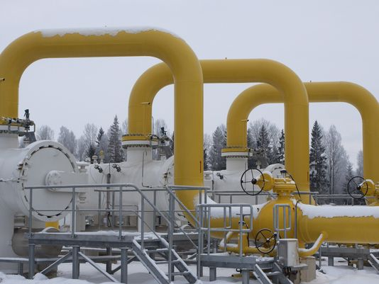
Operations and Maintenance

Slide 9
§192.605(a) General
An operator must have a manual for Operations, Maintenance and Emergency Response
Must be reviewed each calendar year, not to exceed 15 months
Must be prepared before pipeline operation
Must be available to operations and maintenance personnel
Transmission operators must have procedures for Abnormal Operations

Slide 10

Support Documentation §192.605(a)
O&M Revision History
MOC Documents
Procedure and Emergency Manual Availability
List of identified Abnormal Operations

Slide 11
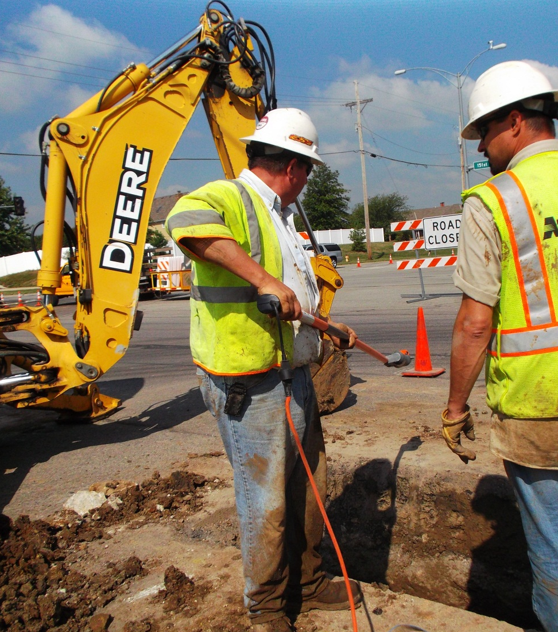
§192.605(b) Maintenance and Normal Operations
The O&M manual must include procedures for the following, if applicable, to provide safety during maintenance and operations.

Slide 12
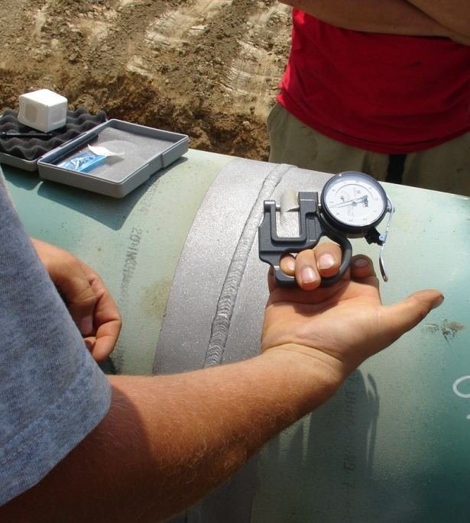
§192.605(b) Maintenance and Normal Operations
Procedures for:
Operating, maintaining and repairing the pipeline
Controlling corrosion
Making construction records, maps, and operating history available to personnel

Slide 13
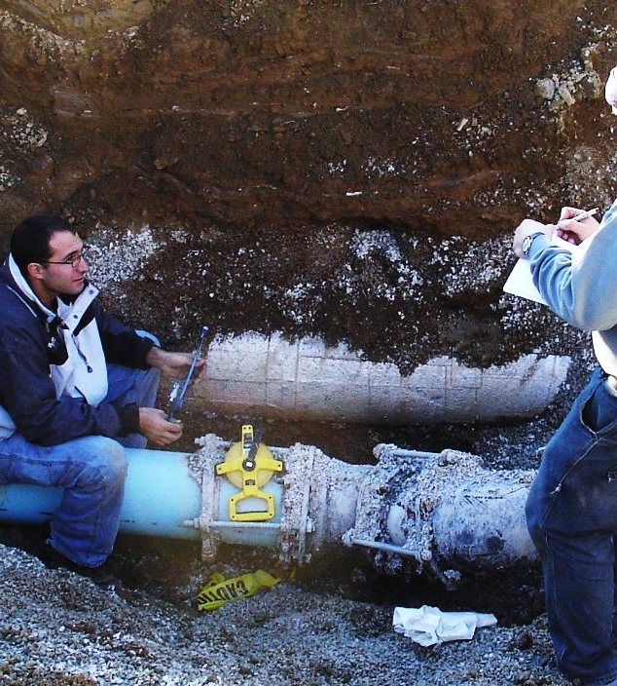
§192.605(b) Maintenance and Normal Operations
Procedures for:
Gathering data for reporting incidents under part 191
Safely starting up and shutting down a pipeline
Purging, isolating and maintaining compressor stations

Slide 14
Support Documentation §192.605(b)
Pressure Charts
SCADA Data
Maintenance Documents
Work Orders
Corrosion Readings
Corrosion Inspections (Atmospheric)
Vault Inspections
Construction As-Builts
Service Drawings
Leak Surveys
Maps
Incident Reports
Safety-Related and AOC Reports

Slide 15
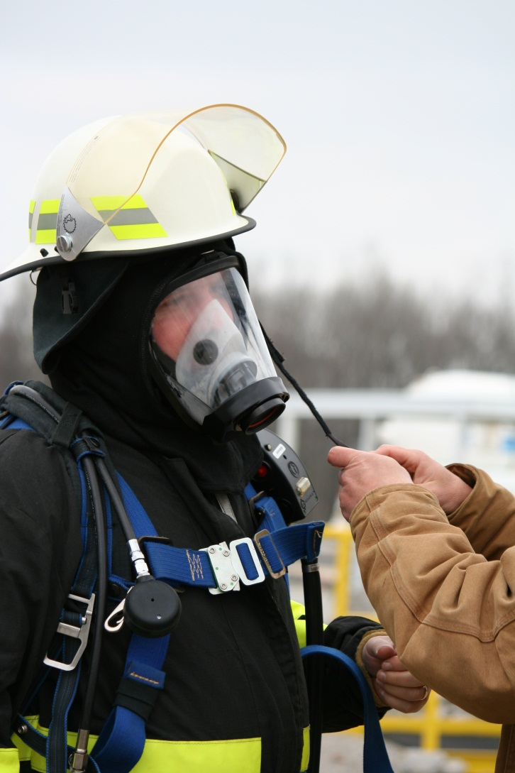
§192.605(b) Maintenance and Normal Operations
Procedures for:
Starting, operating, and shutting down compressors
Periodic review of existing procedures
Precautions and equipment needed to ensure safety in a gaseous atmosphere

Slide 16
Support Documentation §192.605(b)
MOC documents
  Control Room
  Transmission
  OQ
Training
  Programs
  Rosters
  Schedules
Compressor Maintenance Logs
Maintenance Documentation for:
  CGIs and Flame Packs (Calibration)
  Fire Extinguishers
  Air Bottles
  Air Filtration (Compressors)
  And Other Personal Protective Equipment

Slide 17
§192.605(b) Maintenance and Normal Operations
Procedures for:
Testing and inspection of bottle type holders
  Detecting corrosion and remaining strength of containers
  Sampling and testing of gas dew points for corrosion control and/or interference in operations
  Inspection of pressure limiting devices

Slide 18
Support Documentation §192.605(b)
Bottle Type Holders
  Inspection Documents
  Inspection Criteria
  Training Documents
  Strength Calculations
  Lab Results
  Operational History
  Refill Sheets
Pressure Limiting Devices:
  Inspection Documents
  Testing Criteria
  Manufacturers Manuals
  Spring Color or Length
  Orifice Sizes
  Set Points

Slide 19
§192.605(b) Maintenance and Normal Operations
Procedures for:
Responding promptly to a report of a gas odor inside or near a building, unless the operator's emergency procedures under §192.615(a)(3) specifically apply to these reports.
Implementing the applicable control room management procedures required by § 192.631.

Slide 20
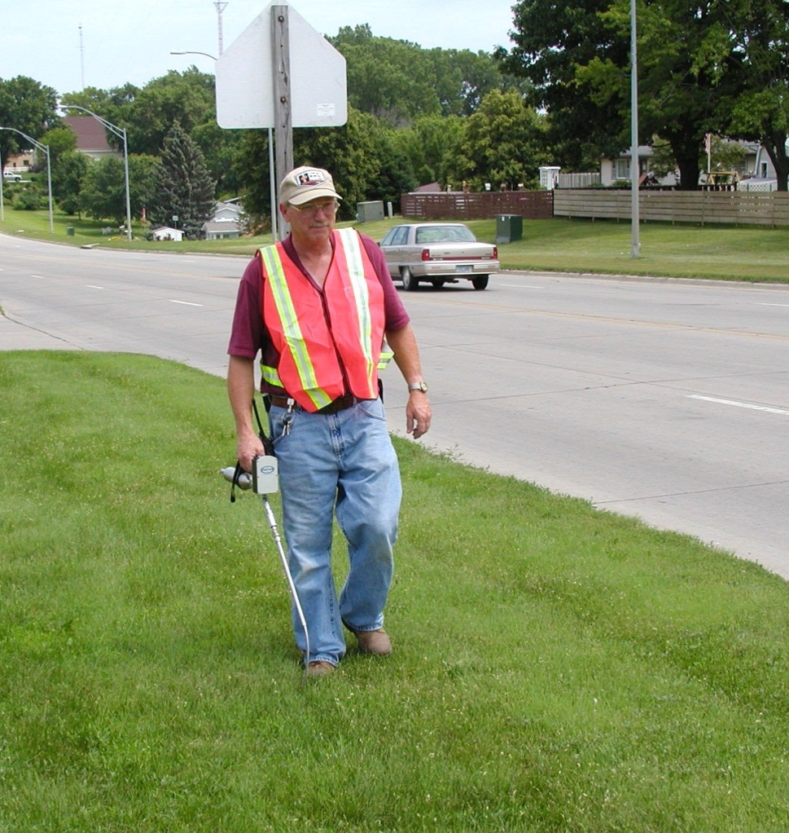
Support Documentation §192.605(b)
Leak Reports
Field Survey Reports
Emergency Repair Documents
Incident/Accident Logs
Control Room
  Hand Over Documents
  Failure/Repair Logs
  Communication Logs

Slide 21
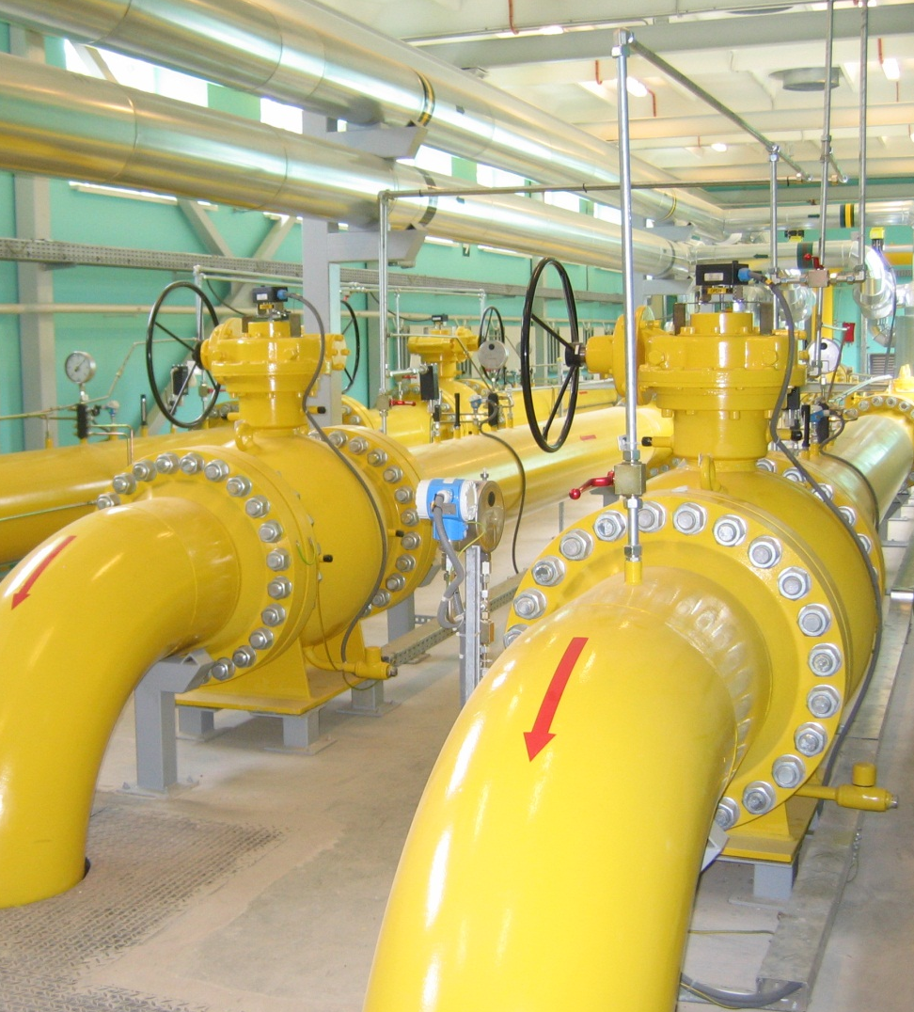
§192.605(c) Abnormal Operation
For transmission lines, procedures for the following to provide safety when operating design limits have been exceeded:

Slide 22
§192.605(c) Abnormal Operation
Transmission Procedures for:
  Responding to, investigating, and correcting the cause of:
    Unintended closure of valves or shutdowns;
    Increase or decrease in pressure or flow rate outside normal operating limits;
    Loss of communications;
    Operation of any safety device; and,
    Any other foreseeable malfunction of a component, deviation from normal operation, or personnel error which may result in a hazard to persons or property.

Slide 23
§192.605(c) Abnormal Operation
Transmission Procedures for:
  Checking critical locations to ensure system integrity after an emergency
  Notifying responsible operator personnel when notice of an abnormal operation is received.
  Review response to ensure effectiveness of procedures

Slide 24
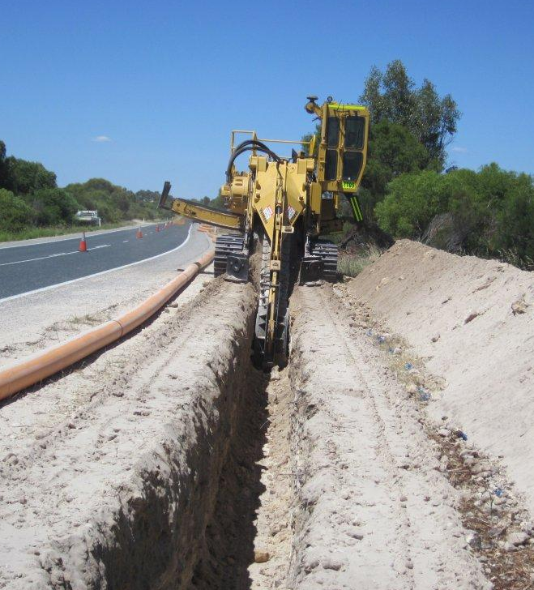
§192.605(c) Abnormal Operation
Paragraph (c) does not apply to natural gas distribution operators that are operating transmission lines in connections with their distribution system.

Slide 25
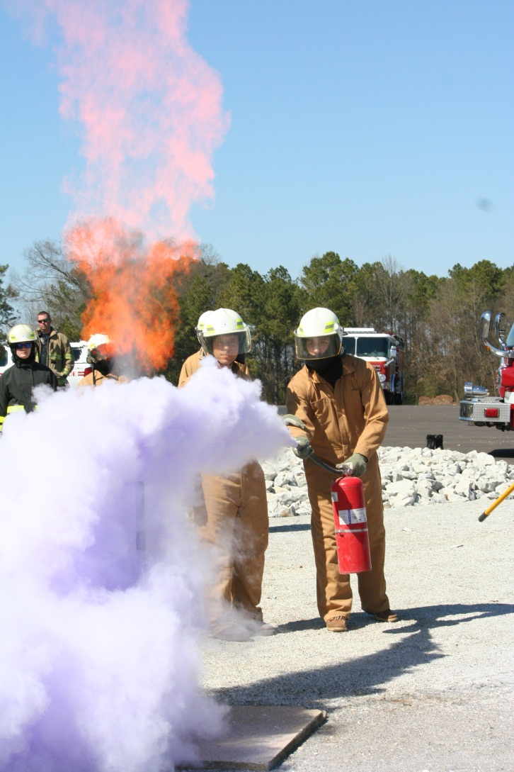
§192.605(d) Safety-Related Condition Reports
Procedures for:
Instructions enabling personnel who perform O&M activities to recognize conditions that potentially may be safety-related conditions that are subject to the reporting under §191.23

Slide 26
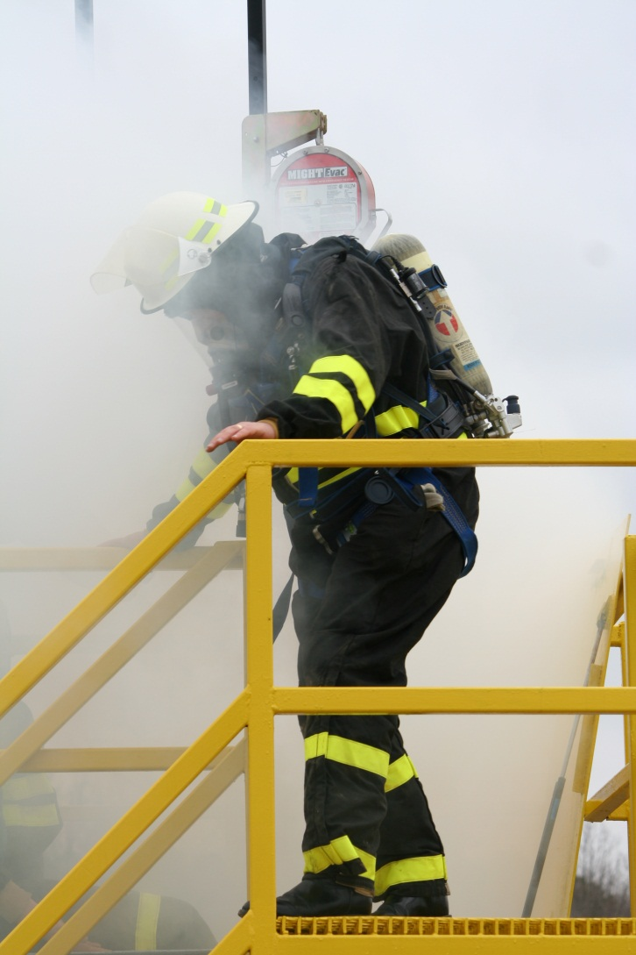
§192.605(e) Surveillance, emergency response, and accident investigation.
The procedures required by §§192.613(a), 192.615, and 192.617 must be included in the O&M manual

Slide 27
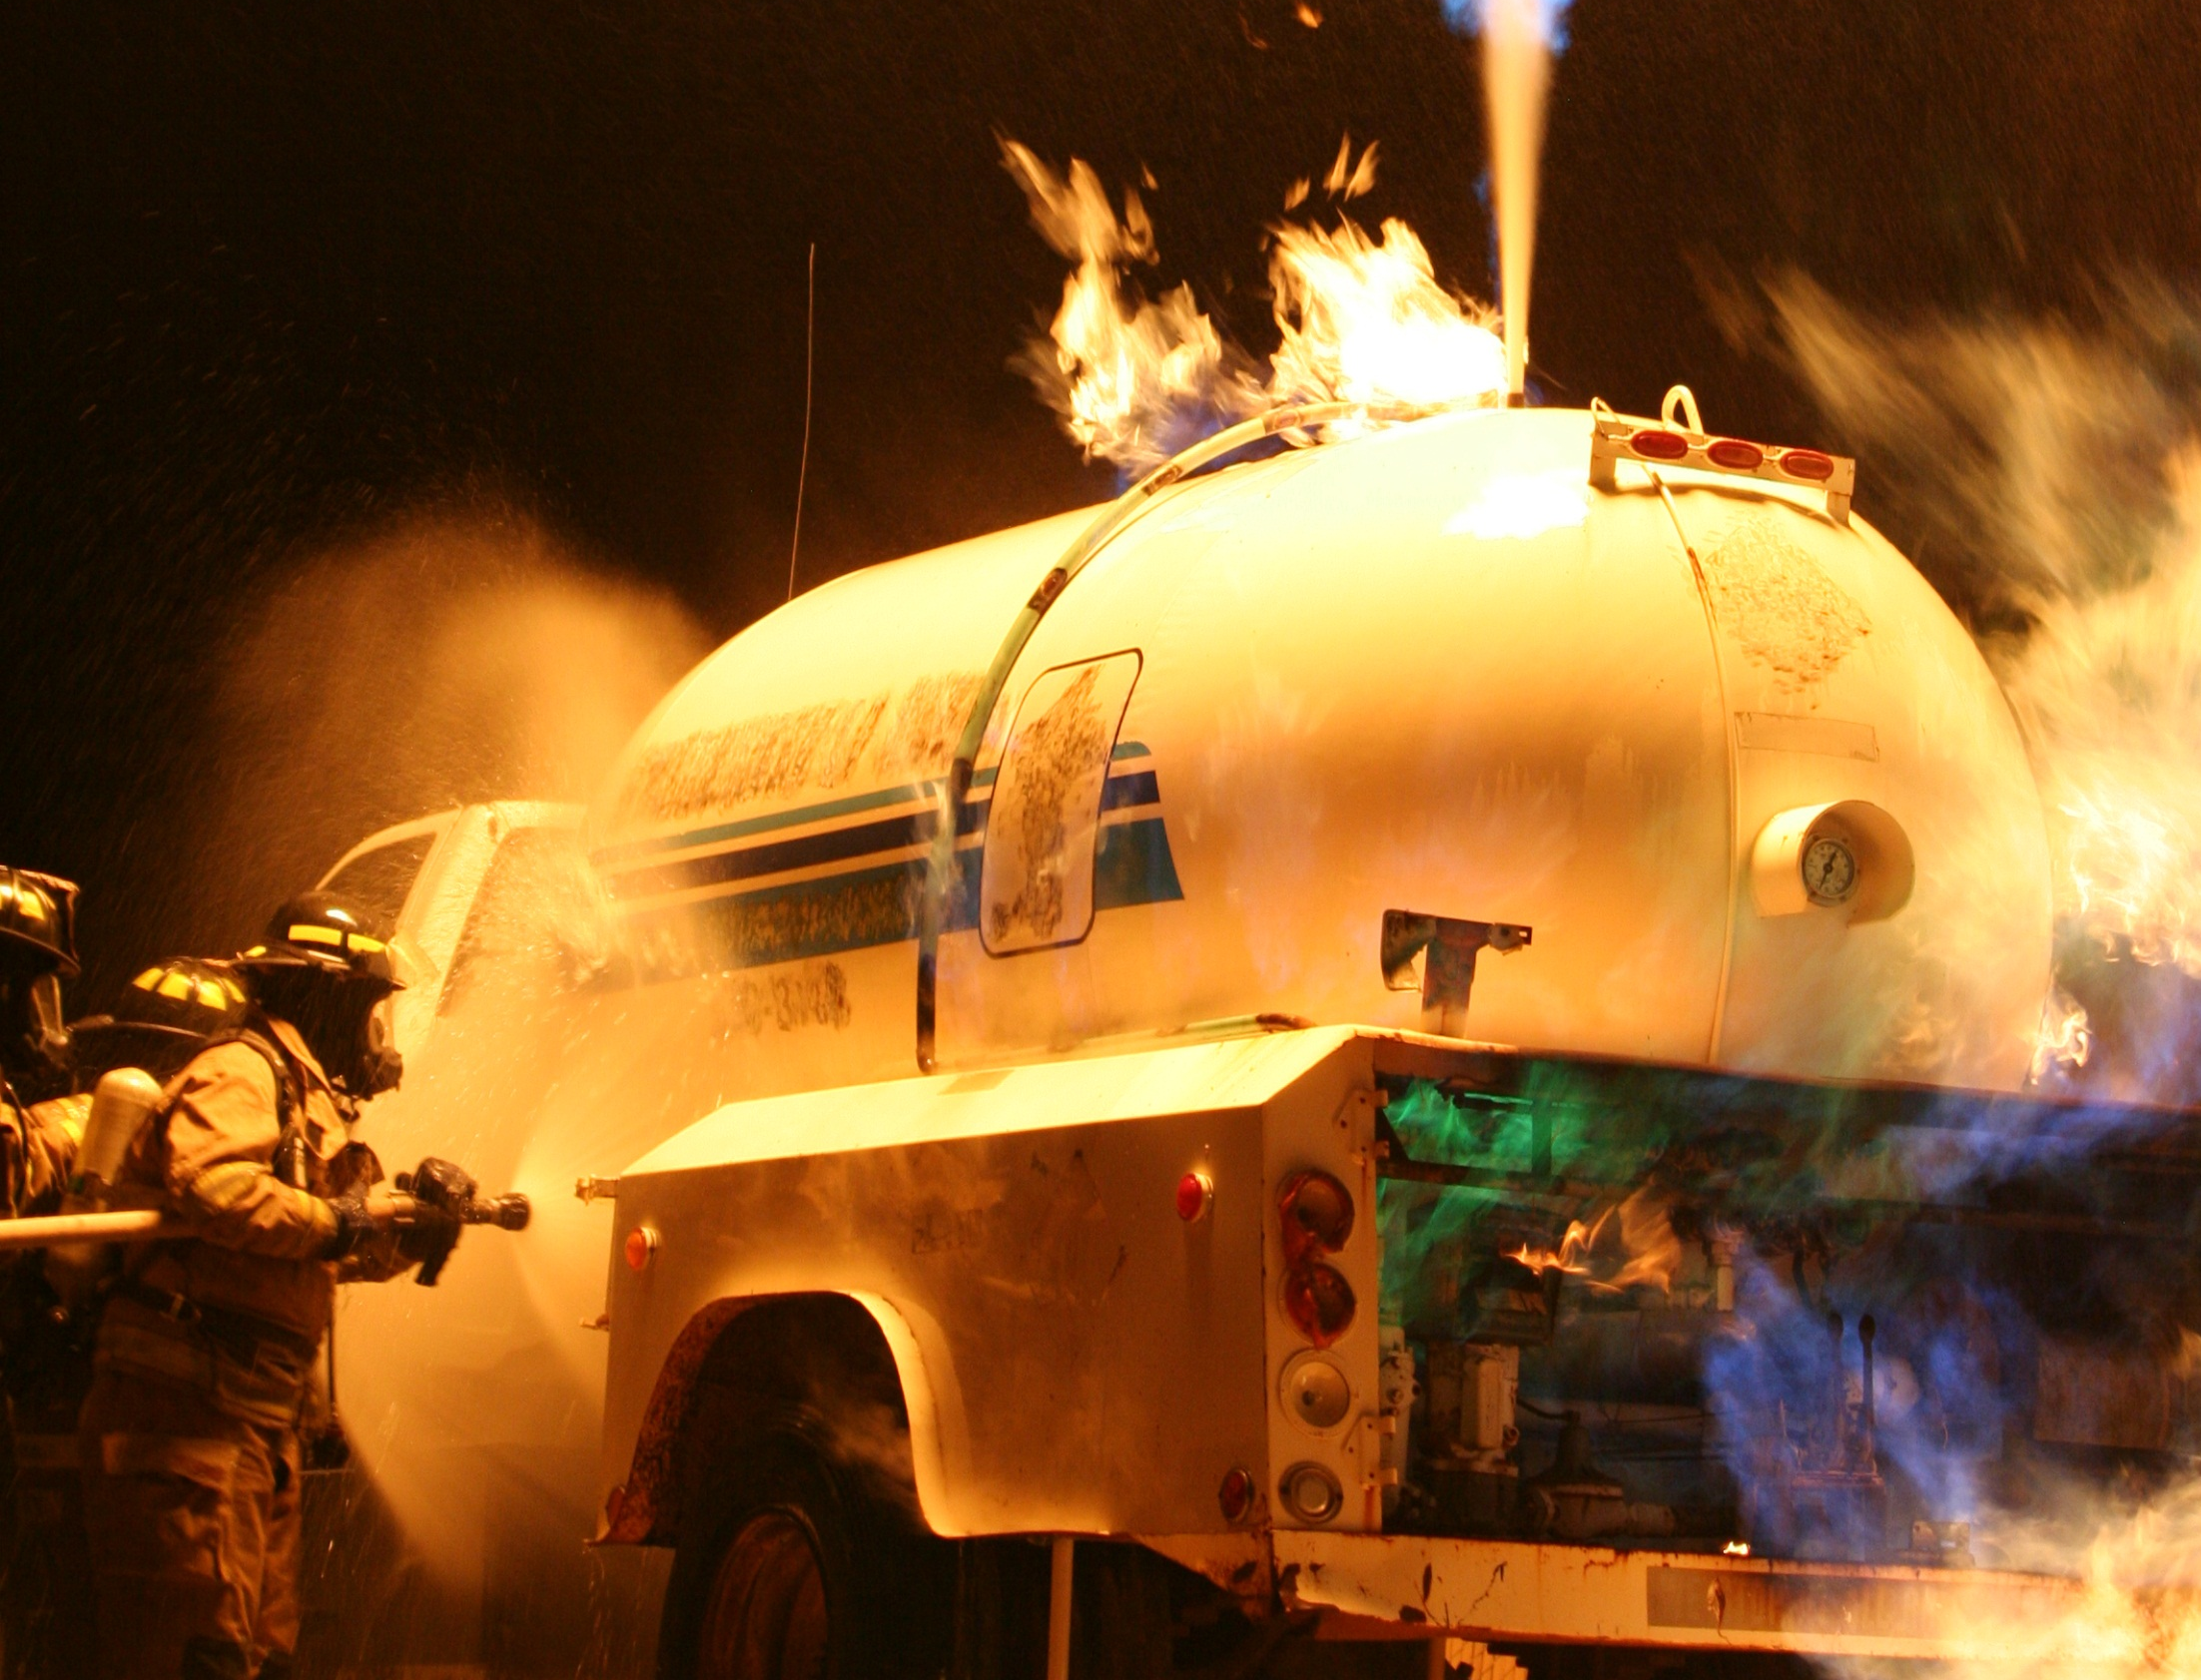
Emergency Plans

Slide 28

§192.615(a) Emergency plans
Each operator shall establish written procedures to minimize the hazard resulting from a gas pipeline emergency. At a minimum, the procedures must provide for the following:

Slide 29
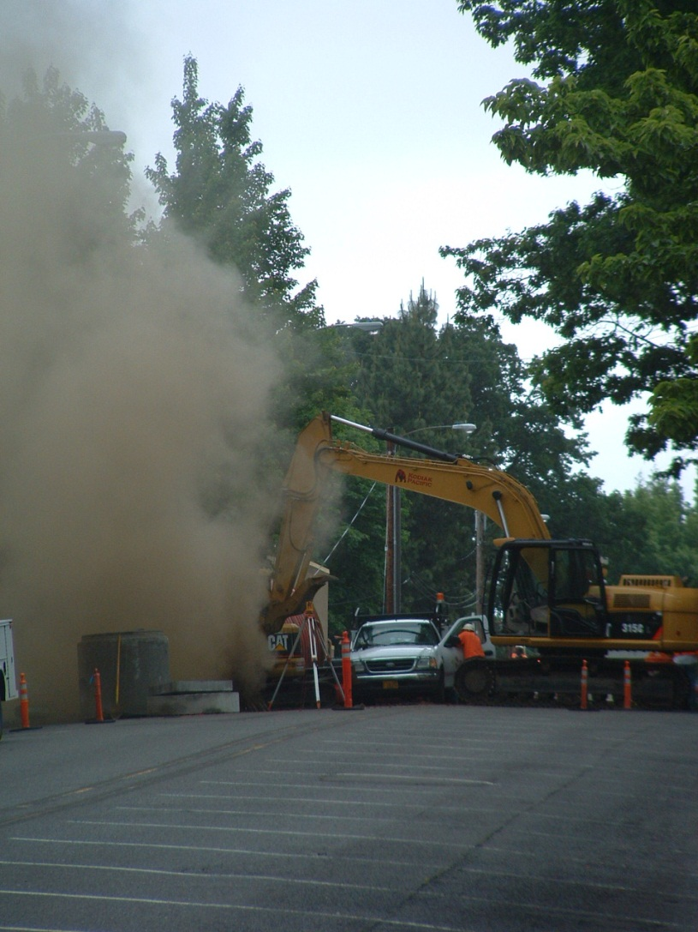
§192.615(a) Emergency plans
Procedures for:
Receiving, identifying, and classifying notices of events which require immediate response
Establishing and maintaining adequate means of communication with appropriate fire, police, and other public officials.

Slide 30
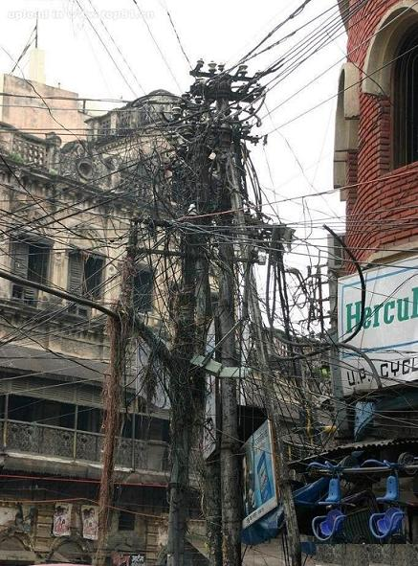
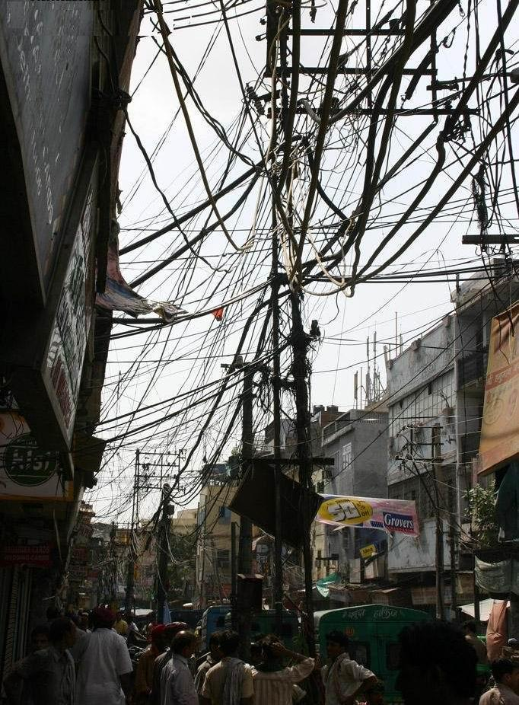
Communication Issues

Slide 31
Event Classifications
  Immediate Response
  Next Available Person
  Within an Hour

Slide 32
Support Documentation §192.615(a)
Dispatch Logs
Control Room Logs
Dispatcher Training
Leak Classifications
Communication Plans
Response Training
Contact Information for:
  Stand by Personnel
  Fire Departments
  Police
  Other Utilities
  911
  Public Officials
  State Agencies
  Federal Agencies

Slide 33
§192.615(a) Emergency plans
Procedures for:
Prompt and effective response to a notice of each type of emergency
  Gas detected inside or near a building
  Fire located near or directly involving a pipeline facility.
  Explosion occurring near or directly involving a pipeline facility.
  Natural disaster.

Slide 34
Documentation
How should we respond?
What should we respond to?
When should we respond?
What do we need to respond?
Who should we contact?
Where should our response start?
Etc …

Slide 35
§192.615(a) Emergency plans
Procedures for:
The availability of personnel, equipment, tools, and materials, as needed at the scene of an emergency.
Actions directed toward protecting people first and then property.
Emergency shutdown and pressure reduction in any section of the operator's pipeline system

Slide 36
Documentation
Multiple direct contacts for each organization
Current equipment and resource lists
Roles and responsibilities (Police and Fire)
Strategy (People -> Property -> Pipeline)
Shutdown, shut-in, reduction, or reroute of product
Reporting
Chain of command

Slide 37
Actions directed toward protecting people first and then property.
    H Hazard
    E Extent
    L Life
    P Property
    S Safe

Slide 38
§192.615(a) Emergency plans
Procedures for:
Making safe any actual or potential hazard to life or property.
Notifying and coordinating with fire, police, and other public officials on both planned and emergency responses
Safely restoring any service outage.

Slide 39
Make it Safe!
Teach responders your products properties
Communicate and train with emergency responders
Provide physical and tabletop exercises
Define roles and responsibilities
Ensure a site is safe, and product is contained before restoring service

Slide 40
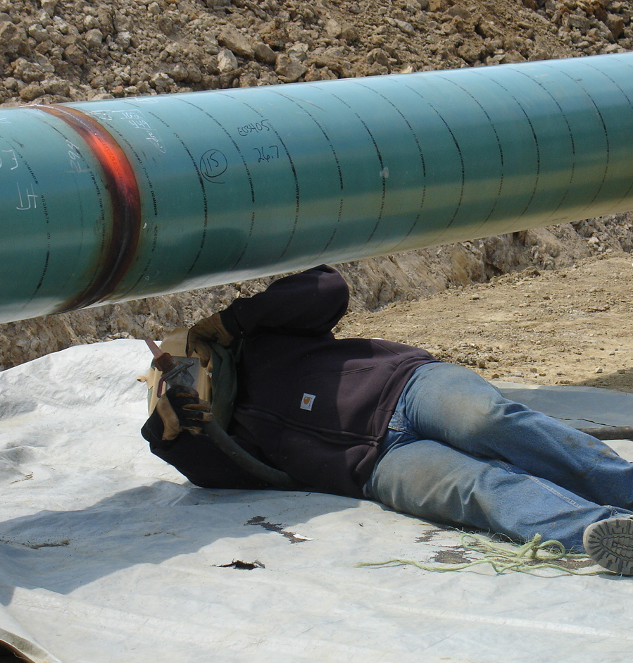
§192.615(a) Emergency plans
Procedures for:
Failure investigation under §192.617, if applicable, ASAP after emergency
Actions required to be taken by a controller during an emergency in accordance with § 192.631.

Slide 41
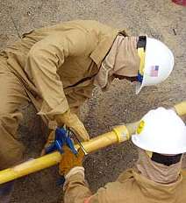
§192.615(b) Emergency plans
Each operator shall:
  Furnish emergency personnel with both a current emergency plan and procedures
  Train personnel and evaluate their effectiveness
  Review employee activities to ensure procedures are effective

Slide 42
§192.615(c) Emergency plans
Each operator shall establish and maintain liaison with appropriate fire, police, and other public officials to:
  Learn the responsibility and resources of each government organization
  Acquaint the officials with the operator's ability in responding
  Identify the types of gas pipeline emergencies of which the operator notifies the officials
  Plan how the operator and officials can engage in mutual assistance to minimize hazards to life or property.

Slide 43
What is a Liaison?
Liaison:
  Communication or cooperation that facilitates a close working relationship between people or organizations.
Coordination:
  The exchange of information or the planning of joint efforts by two or more people or groups, often of military personnel, or
  A communication for establishing and maintaining mutual understanding and cooperation

Slide 44
Liaison Issues
Generic message to attend meeting doesn’t catch attention
Use term “PIPELINE EMERGENCY”
Use titles rather than names for invitations
Multiple invitations for large departments
Credit for training
Qualify for HAZWOPER or emergency training
Make credits easy
Notes:
Some of the feed back we have received from emergency responders include:
Invitations are often generic, which doesn’t necessarily catch the attention of the persons receiving the invitation.
ER’s suggest using the heading or term pipeline emergencies. That term puts a different spin on it, and catches the eye.
Another suggestion is that the invit6ations be sent to titles, instead of individuals. This is probably particularly true for volunteer fire departments.
For large departments, you might want to sent the invitation to each fire house, rather than just to the fire chief.
Another big desire is to get credit for the training. Meeting attendance might cover requirements for HAZWOPER or emergency training. We are asking these people to give up some of their time, providing credit is one way to do it. And the credit should not be difficult to get.

Slide 45
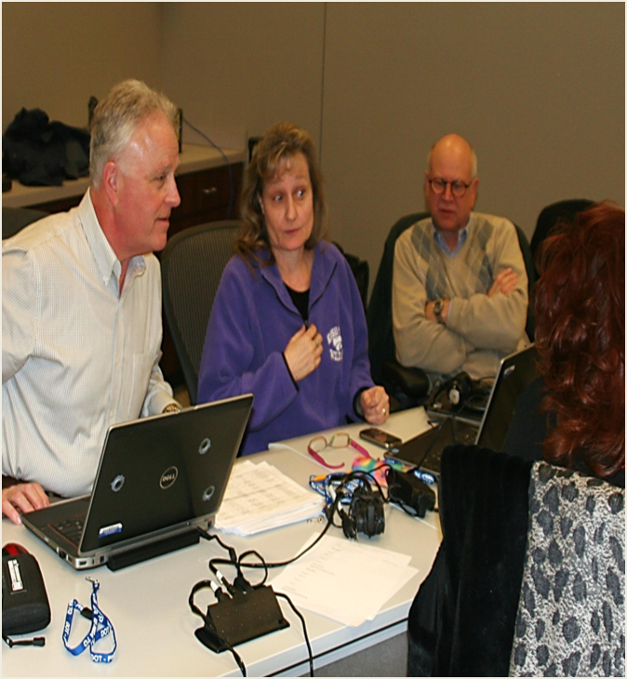
Liaison Meetings
Prefer face to face meetings rather than public meetings
At their facility
Prefer local operations people
Contact all shifts
Volunteer departments – weekends rather than weekday
Notes:
The feedback is they don’t necessarilly dislike the public type meeting, but it all gives rather generic information. They would prefer face to face meeting, generally at their facility. These could be done in conjunction with the public meetings.
Ers prefer these face to face meetings at their facilities. Easier to get people together, and they are where they need to be in case of another emergency. They would prefer these meetings to be with the local operations people instead of the headquarters. The reason for this is because the local operations people are the ones they will be dealing with during an emergency.
The contact should be made with all shifts, because information is not necessarily shared between shifts.
For volunteer departments, maybe a meeting on a weekend rather than a weekday. One thing to consider is scheduling joint drills on weekends instread of weekdays.

Slide 46
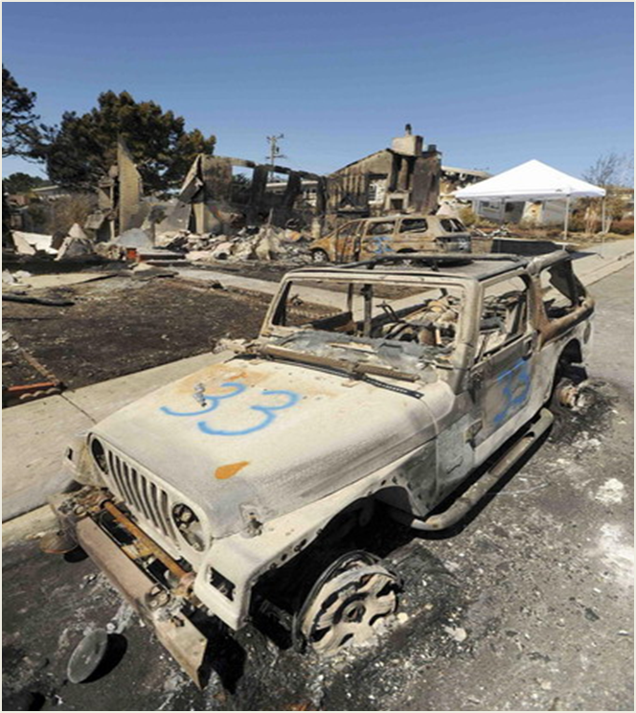
Emergency Plans
ADB – 10 – 08 – Emergency Plans
Don’t want full plan
Quick reference on:
  what to do and
  contact lists
Portable – multiple copies and available in their vehicles
Notes:
ADB 10-08 was one fo the first reaftions to San Bruno. It could have been worded differently. The gist of this is to provide emergency plan information to the local first responders. PHMSA does not mean the full plan, and the first responders do not want the full plan. But as an operator, it should be the appropriate sections of the plan, which means contact lists, and how first responders and operrator employees will work together. It might include a discussion on communications as well.
FR are looking for a quick reference on what to do, and the local contact lists, not just the 800 number. They would prefer these to be portable, some samml book they could carry in their vehicles. And it should be multiple copies, not just the fire chief. Again, maybe one or two for each fire station, or multiple copies to the local volunteer department so they can distribute them as needed.

Slide 47
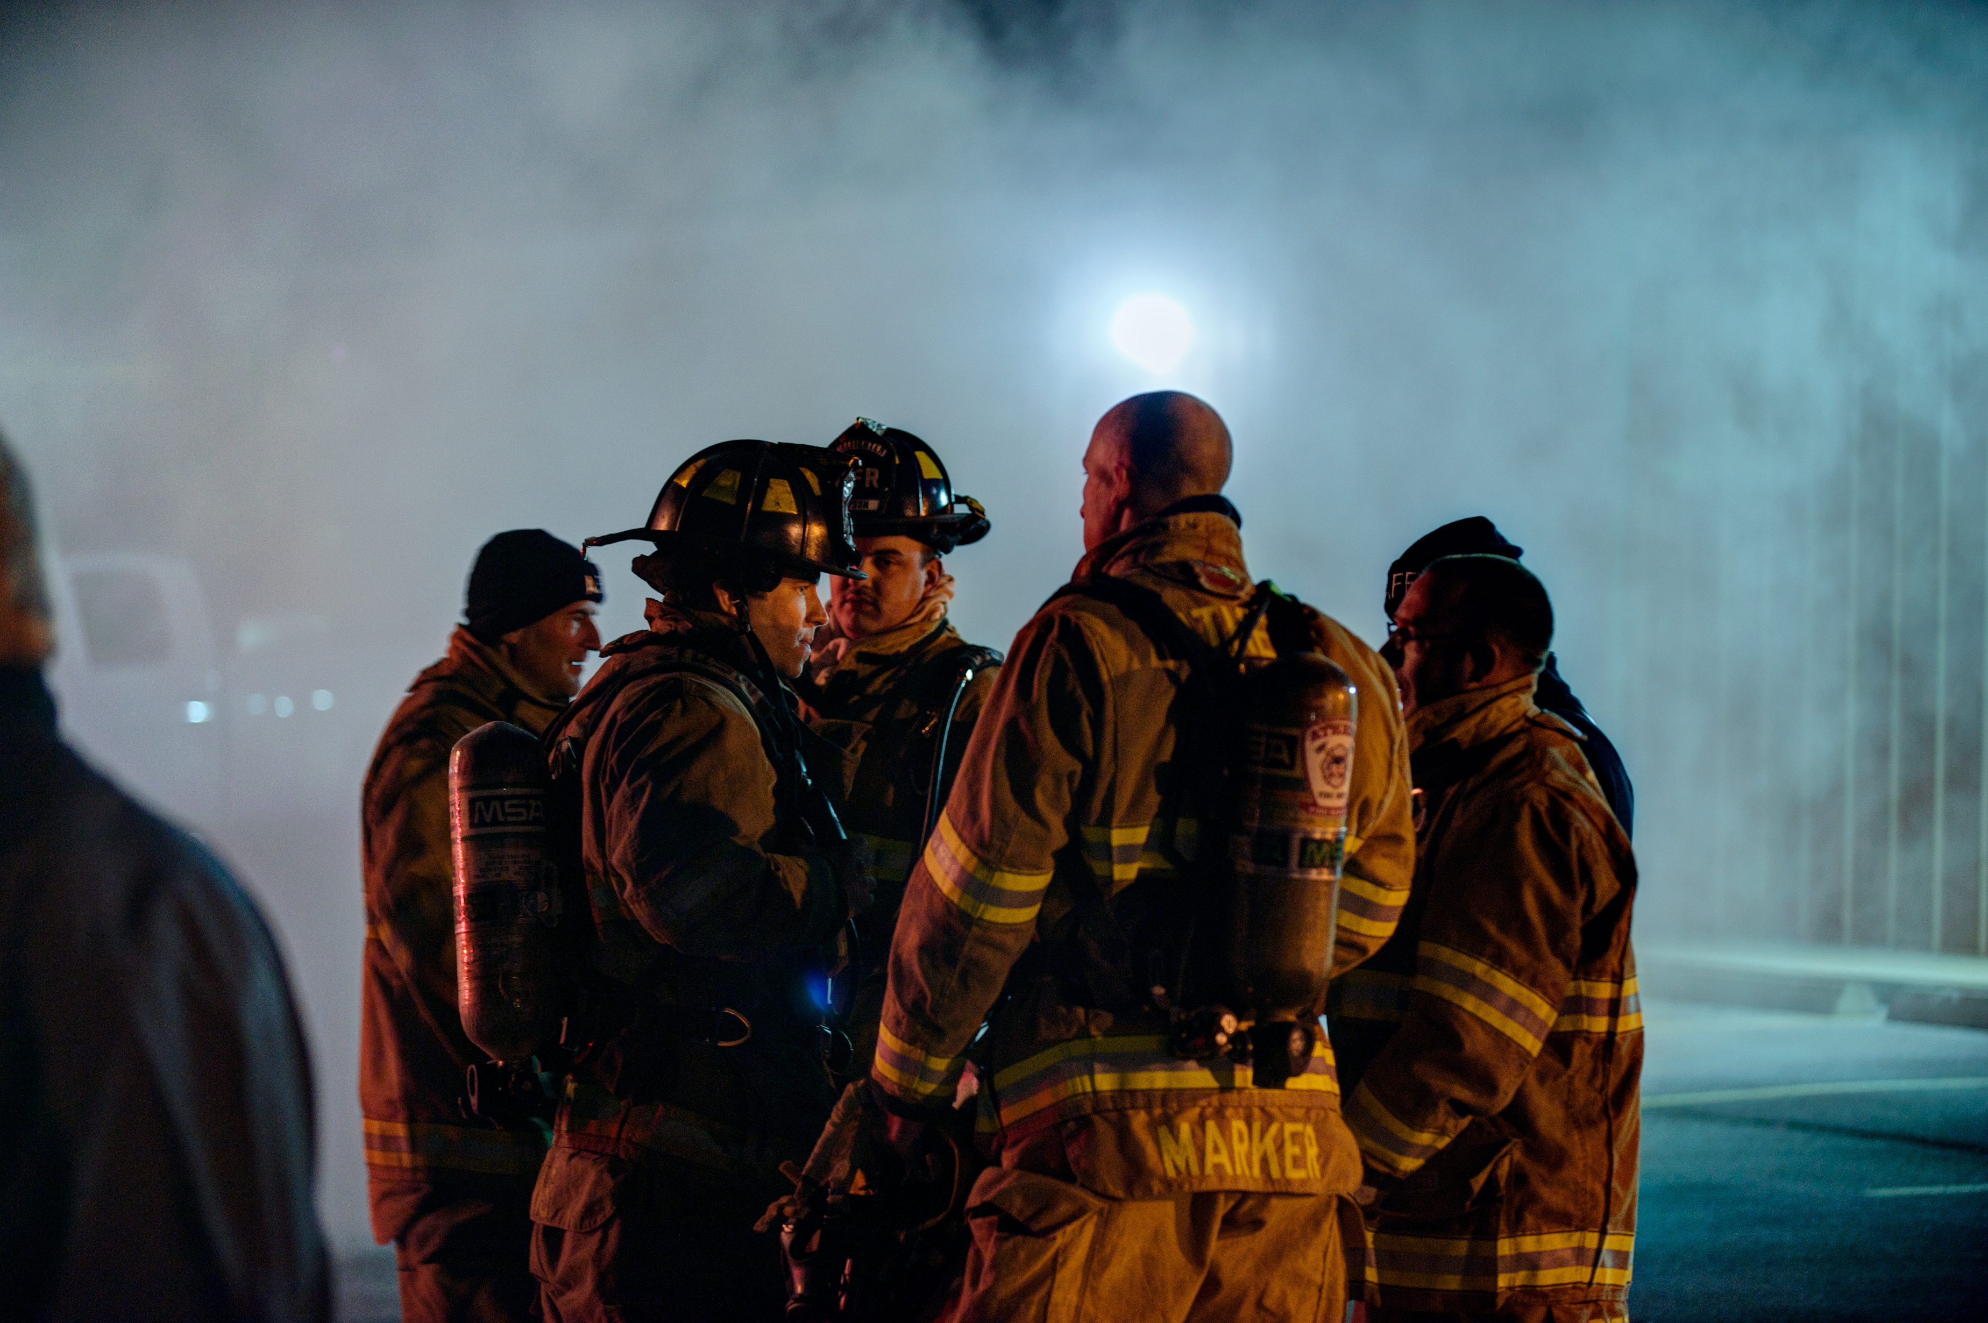
Don’t forget
Activities under §192.615 may also be credited to §192.616 – Public Awareness
  Drills, planning meetings
Document, document, and document some more
Notes:
The feedback is they don’t necessarilly dislike the public type meeting, but it all gives rather generic information. They would prefer face to face meeting, generally at their facility. These could be done in conjunction with the public meetings.
Ers prefer these face to face meetings at their facilities. Easier to get people together, and they are where they need to be in case of another emergency. They would prefer these meetings to be with the local operations people instead of the headquarters. The reason for this is because the local operations people are the ones they will be dealing with during an emergency.
The contact should be made with all shifts, because information is not necessarily shared between shifts.
For volunteer departments, maybe a meeting on a weekend rather than a weekday. One thing to consider is scheduling joint drills on weekends instread of weekdays.

Slide 48
Thanks!
??????
Bryan Kichler
PHMSA T&Q
Bryan.kichler@dot.gov

