Slide 1
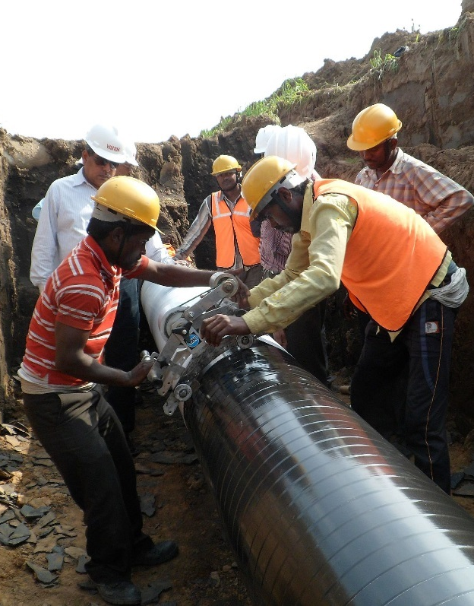
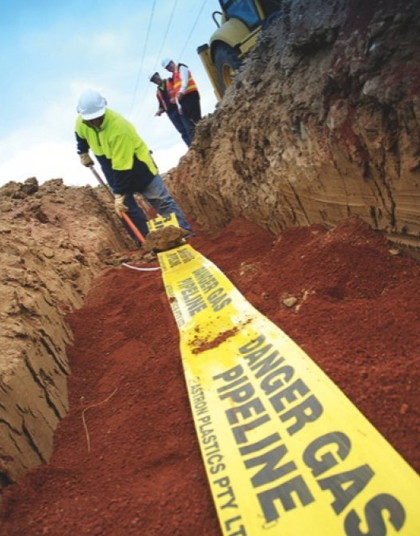
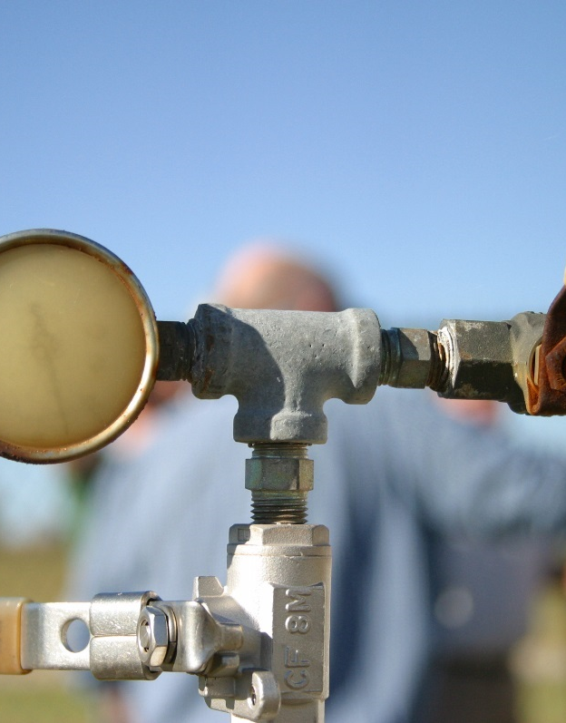
UTPS
NATURAL GAS PIPELINE
SAFETY SEMINAR
Notes:
Good morning everyone and thank you for having me. My name is Jill Nelson and I worked for the Pipeline and Hazardous Materials Safety Administration or PHMSA for the past 20 years. I am Instructor at PHMSA’s Training and Qualifications Center in Oklahoma City.
PHMSA's mission is to protect people and the environment by advancing the safe transportation of energy and other hazardous materials that are essential to our daily lives. To do this, the agency establishes national policy, sets and enforces pipeline safety regulations, educates state and federal pipeline safety inspectors, and conducts research to prevent incidents. We also participate in seminars, such as this one, to inform operators about the pipeline safety regulations and to keep our finger on the pulse of the real world that you work in.
Today I will be discussing some of the basics of regulatory compliance for natural gas operators.

Slide 2
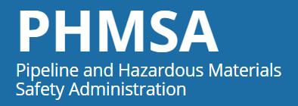
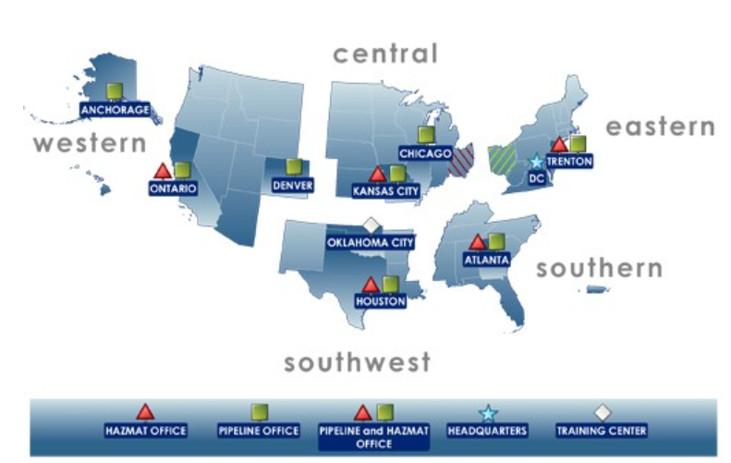
Jill Nelson
Transportation Specialist
Instructor
Inspector Training & Qualifications Division

Slide 3
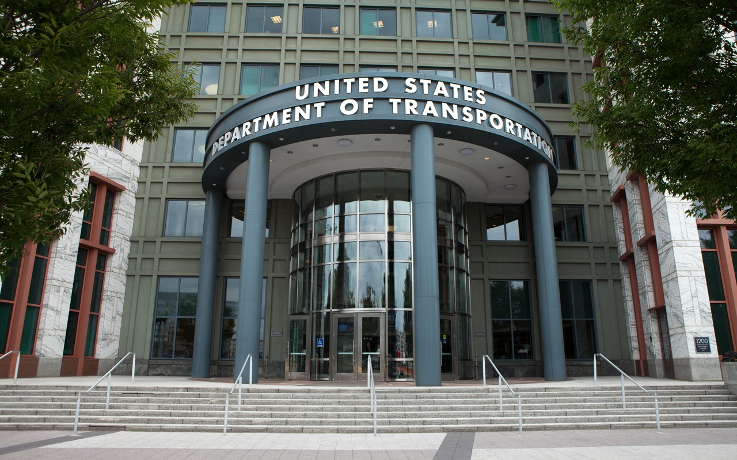
PHMSA Mission Statement
PHMSA's mission is to protect people and the environment by advancing the safe transportation of energy and other hazardous materials that are essential to our daily lives. To do this, the agency establishes national policy, sets and enforces standards, educates, and conducts research to prevent incidents. We also prepare the public and first responders to reduce consequences if an incident does occur.

Slide 4
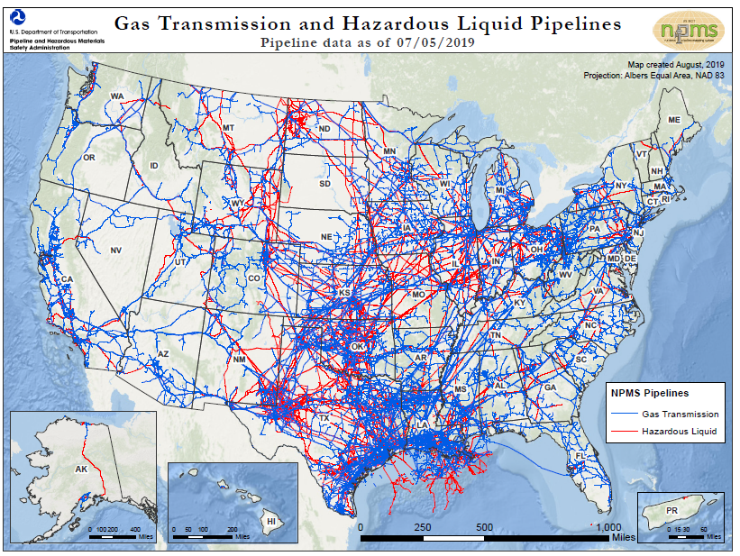
Pipelines in the United States
Pipelines under PHMSA’s regulatory authority carry either gas or hazardous liquids. There is almost 3 million miles of pipelines in the U.S.
  Enough to circle the earth about a hundred times.
About half of the gas pipelines were installed in the 1950 and 60s.
Pipelines exist in every state in the U.S.
Are operated by about 3,000 companies, municipalities and cooperatives.

Slide 5
History and Structure
USC Title 49 Chapter 601
(1968)
ASME B31
(1920s)
Federal
Regulations
Historical
Standards
Parts 190-199
(1970s)
Operator
Operators
O&M
State
Promulgated Rules
(1930s)
State
Regulations
Notes:
USC Title 49 Chapter 601 was the first laws or regulations covering pipeline safety starting in 1968.
In the 70’s parts 190-199 of the Code of Federal Regulations were published. As you all know, these are the same parts that govern the industry today. With this being said, many additions have been published since to cover areas such as; LNG, Underground Storage and many more.
The state promulgated rules are state rules that can be more stringent than that of the federal regulations. These rules must at minimum follow ALL federal codes.
The Operators O & M manuals are created based off of the State Promulgated Rules and the Federal Regulation and can also be more stringent than both state and federal regulation. Federal and state regulators will always inspect to the
O & M manual. In other words, for leak-survey for instance, if the Federal regulation requires a 100% leak survey every 5 years, the state regulation may require 100% leak survey every 3 years and the Operators O & M manual requires 100% leak Survey annually. The inspector will inspect to the O & M Manual for the requirement of 100% leak survey annually. Where this gets tricky is when pipelines are interstate vs intrastate. That is a whole other presentation in and of itself.

Slide 6
The early years 1915-1925 ASME B31
Need for a national code for pressure piping
To meet this need, the American Engineering Standards Committee - now the American National Standards Institute initiated Project B31 in March 1926.
B31 and its subcommittees was published in 1935 as an American Tentative Standard Code for Pressure Piping.
ASME B31/B31.1/B31.4/B31.8 Codes were the only US pipeline standards until 1968

Slide 7
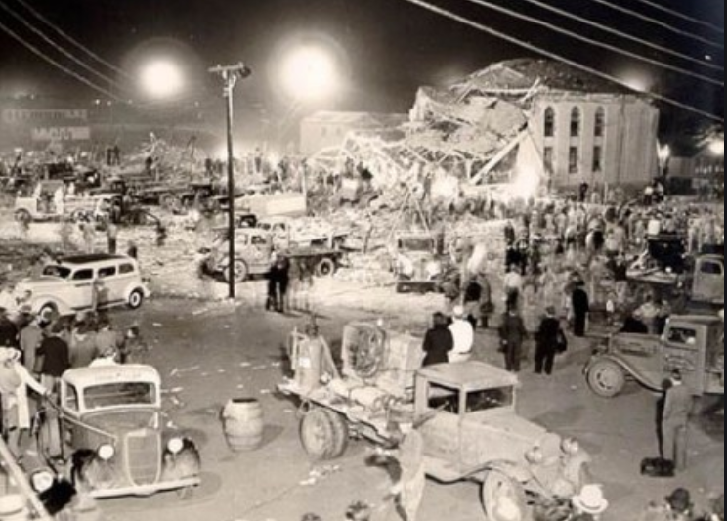
New London, Texas March 18, 1937
Killed more than 295 students and teachers
As a result of the disaster, Texas was the first state to pass laws requiring that natural gas be mixed with a “malodorant” to give early warning of a gas leak.
Other states quickly followed.

Slide 8

Title 49 of the Code of Federal Regulations
Publication of Title 49 began in 1938. It was titled Transportation and Railroads. It was renamed in 1949 to “Transportation”
The United States Department of Transportation established by an act of Congress in 1966, and began operation on April 1, 1967.

Slide 9
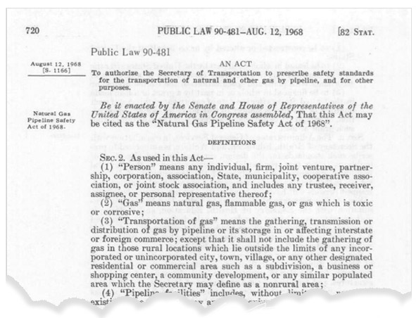
Office of Pipeline Safety (OPS) 1968
Congress created the Office of Pipeline Safety (OPS) in 1968 to oversee and implement pipeline safety regulations.
OPS is housed in the Department of Transportation (DOT) under Pipeline and Hazardous Materials Safety Administration (PHMSA).
OPS oversees interstate pipelines while states are responsible for intrastate pipelines.
Basis of current codes
Amended to correct, modify and add requirements

Slide 10
CFR 49 Part 190-199
Congress adopts The Natural Gas Pipeline Safety Act on August 12, 1968
DOT, adopts existing state standards within 3 months as interim standards Part 190
Interim standards were essentially ASME B31.8
Part 192 Final Rule on August 19, 1970

Slide 11
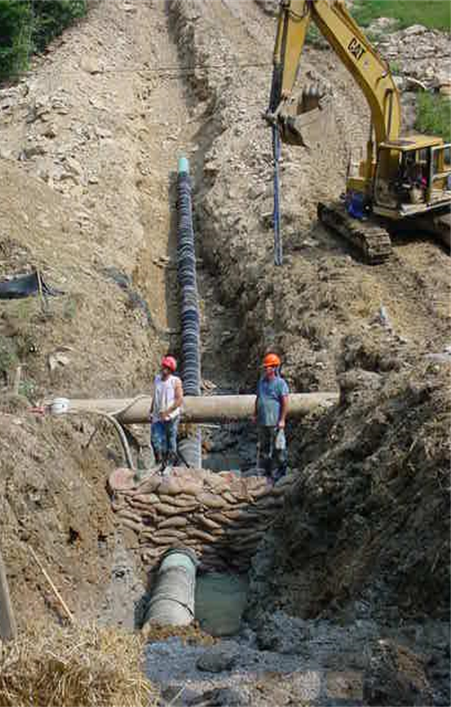
Pipeline Codes
49 CFR 190 – Pipeline Safety Program Procedures
49 CFR 191 – Transportation of Natural and Other Gas by Pipeline; Reports of Leaks
49 CFR 192 – Transportation of Natural and Other Gas by Pipeline; Minimum Federal Safety Standards
Notes:
Part 190 Covers Pipeline Safety Program Procedures
49 CFR 191 – This is the section that covers reporting procedures. To include Reports of Leaks or incidents
All of you should be aware of Part 192 – Which Covers Transportation of Natural and Other Gas by Pipeline; Minimum Federal Safety Standards

Slide 12
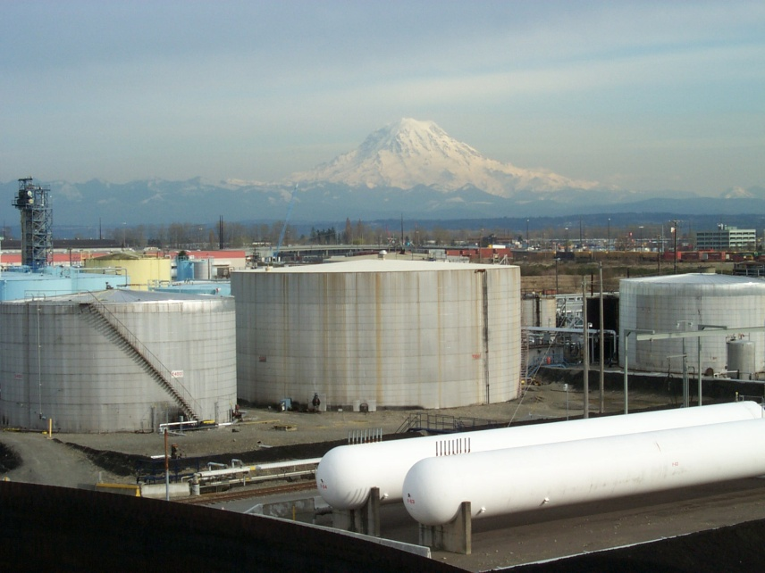
Pipeline Codes
49 CFR 193 – Liquefied Natural Gas: Federal Safety Standards
49 CFR 195 – Transportation of Hazardous Liquids by Pipeline
49 CFR 199 – Drug and Alcohol Testing Regulations and Procedures
Notes:
49 CFR 193 – Liquefied Natural Gas: Federal Safety Standards
49 CFR 195 – Transportation of Hazardous Liquids by Pipeline. This includes petroleum, petroleum products, anhydrous ammonia, or ethanol. These regulations also cover liquid Carbon Dioxide pipelines.
49 CFR 199 – Drug and Alcohol Testing Regulations and Procedures

Slide 13
Code and Standards Interaction
API
Part 192 interacts with other setting documents.
Part 192 is approximately 152 pages.
When incorporating all of these documents it is1000’s of pages.
NFPA
Part 192
USC and Parts 190-199
ASME
ASTM
Notes:
This slide shows how Part 192 interacts with all other setting documents. Part 192 is approximately 152 “easy to read pages” however; when incorporating all of these documents you are talking about literally 1000’s of pages, which becomes much trickier to read.
Specifically IBR or incorporated by reference docs become part of the code for the operator.

Slide 14
Standards Referenced in ASTM D2513-12ae1
CFR 49 Part 192 incorporates ASTM D2513-12 advanced edition 1, which is the plastics pipe standard. All of these documents are incorporated into it. PHMSA incorporates over 60 standards into just Part 192.
CFR 49 part 192
ASTM D2513-12ae1
PPI TR-9
ASTM D2683
NFPA 58
PPI TR-33
MIL-STD-129
ASTM D2290
ASTM D3350
ASTM D3261
ISO 9080
PPI TR-41
ASTM F1055
ASTM F412
ASTM D2774
MIL-STD-1235
ASTM F2620
ASTM D638
ASTM F1563
ASTM D2837
ASTM D2122
ASTM F2138
ISO 13477
ISO 13478
ASTM D1238
ANSI B 31.8
ASTM D1599
ASTM D618
ISO 12162
ASTM D1600
ASTM D1898
ANSI B 16.40
ASTM D1598
ASTM D543
ASTM F1473
ISO 4437
Notes:
Here you can see that, CFR 49 Part 192 incorporates ASTM D2513-12 advanced edition 1, which is the plastics pipe standard. Now if you look at all of the branches off of D2513-12ae1 all of these documents are also incorporated into this one. PHMSA incorporates over 60 standards into just Part 192.
So for instance we have, Plastic Pipe Institute or PPI TR-33 which is the butt-fusion standard, or the American Society for Testing and Materials ASTM F2620 which is another fusion standard or ASTM F1055 which is the electrofusion standard. We already spoke about ANSI B 31.8.
If you include all of these just for reference for the plastic pipe standard you are looking at roughly 600 additional pages of regulation. I am sure most of you have heard that this year the Plastics Rule was finally incorporated by reference effective Jan. 22, 2019, which is a whole other presentation in itself

Slide 15
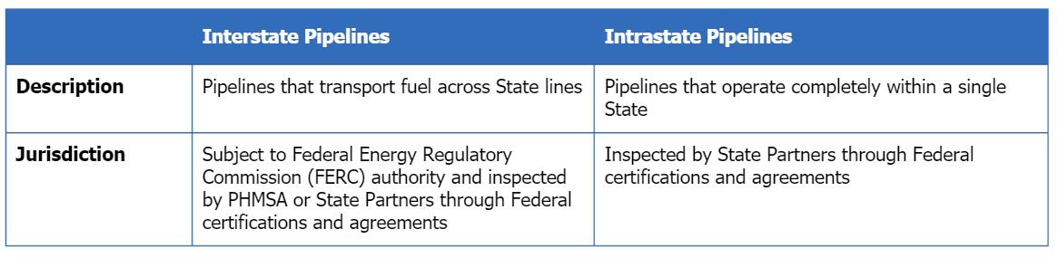
Who Inspects Pipeline Systems?
The jurisdiction under which pipeline systems are inspected depends on whether they are classified as either interstate or intrastate.
Some operators have both interstate and intrastate pipeline, so both PHMSA and the State have interest in those operators. States must be certified by or have an agreement with PHMSA to perform inspections and apply enforcement.

Slide 16
US Code Section 60117(C) Law
(c) Entry and Inspection
  By displaying proper credentials, inspectors have the right to enter the premises
  Inspect records and property
  Reasonable time and manner
Notes:
For instance, section (C) covers the law in regards to entry and inspection. The law states an inspector must display proper credentials, then
inspectors have the right to enter the premises
Inspect records and property at a Reasonable time and manner. The exception to the reasonable time and manner is in the event of an incident or on public property. This leads me into my next slide.

Slide 17

Part 190 Regulatory Authority
§190.203 Inspections and Investigations.
  Upon presenting appropriate credentials authorized to enter upon, inspect, and examine, at reasonable times and in a reasonable manner, the records and properties of persons to the extent such records and properties are relevant to determining the compliance of such persons with the requirements of 49 U.S.C. 60101 et seq., or regulations, or orders issued there under.
Notes:
Upon presenting appropriate credentials authorized to enter upon, inspect, and examine, at reasonable times and in a reasonable manner, the records and properties of persons to the extent such records and properties are relevant to determining the compliance of such persons with the requirements of 49 U.S.C. 60101 et seq., or regulations, or orders issued there under.
An operator may ask who has the authority to do an inspection of my system, and where did they get it? The authority was given to PHMSA by congress under the pipeline safety laws for transportation of hazardous materials by pipeline. An operator can NOT deny access to documents and records that are outside of the retention interval or deny access to inspectors taking photographs.

Slide 18
When are inspection conducted?
§190.203 Inspections and Investigations.
  Inspections are ordinarily conducted
    Routine scheduling
    A complaint from a member of the public
    Information obtained from previous inspection
    Report from a State agency participating in the Federal Program under 49 U.S.C. 60105
    Pipeline accident or incident
    Whenever deemed appropriate
Notes:
§190.203 Inspections and Investigations.
Inspections are ordinarily conducted
(1) Routine scheduling
(2) A complaint from a member of the public
(3) Information obtained from previous inspection
Report from a State agency participating in the Federal Program under 49 U.S.C. 60105
Pipeline accident or incident
Whenever deemed appropriate. So an example of this would be a follow-up visit to check on progress of remedial actions.
Inspections may be conducted at different times and for different reasons by PHMSA or a state agency acting as an agent for PHMSA. State programs under such an agreement are audited by PHMSA on an annual basis to verify their program performance.

Slide 19
§192.15 Rules of regulatory construction.
(a) As used in this part:
  "Includes" means "including but not limited to.“
  "May" means "is permitted to" or "is authorized to.“
  "May not" means "is not permitted to" or "is not authorized to.“
  "Shall" is used in the mandatory and imperative sense.
(b) In this part:
  Words importing the singular include the plural;
  Words importing the plural include the singular; and,
  Words importing the masculine gender include the feminine.
Notes:
This is 192.15 straight out of the code book verbatim.
(a) As used in this part:
"Includes" means "including but not limited to.“
"May" means "is permitted to" or "is authorized to.“
"May not" means "is not permitted to" or "is not authorized to.“
"Shall" is used in the mandatory and imperative sense.
(b) In this part:
(1) Words importing the singular include the plural;
(2) Words importing the plural include the singular; and,
(3) Words importing the masculine gender include the feminine.
For instance, there are over 600 should, shall, may’s and musts in the Underground Storage Incorporated by Reference Documents; however out of these 600 there are only just over 200 Shall’s and Must’s that the operator are required to meet.
Basically, this is exactly how the documents must be read and applied by the operator. In other words, the verbiage can become confusing and it is important to understand the differences between these words.

Slide 20
U.S. Code Title 49 Chapter 601
U.S. Code Chapter 601 is the Law and 49 CFR is the regulation.
Covers the pipeline safety acts.
Covers areas such as Authority, Enforcement and Jurisdiction.
This law also incorporates 49 CFR regulation.
Definitions
Rights
Special permits/Waivers
Authority
Jurisdiction
Enforcement
Notes:
Basically, chapter 601 – covers the pipeline safety act. Most people do not even know it exists, let alone that it covers other areas such as Authority, Enforcement and Jurisdiction to name a few. This law is detailed 49 CFR regulation. Chapter 601 is the Law and 49 CFR would be the regulation.

Slide 21
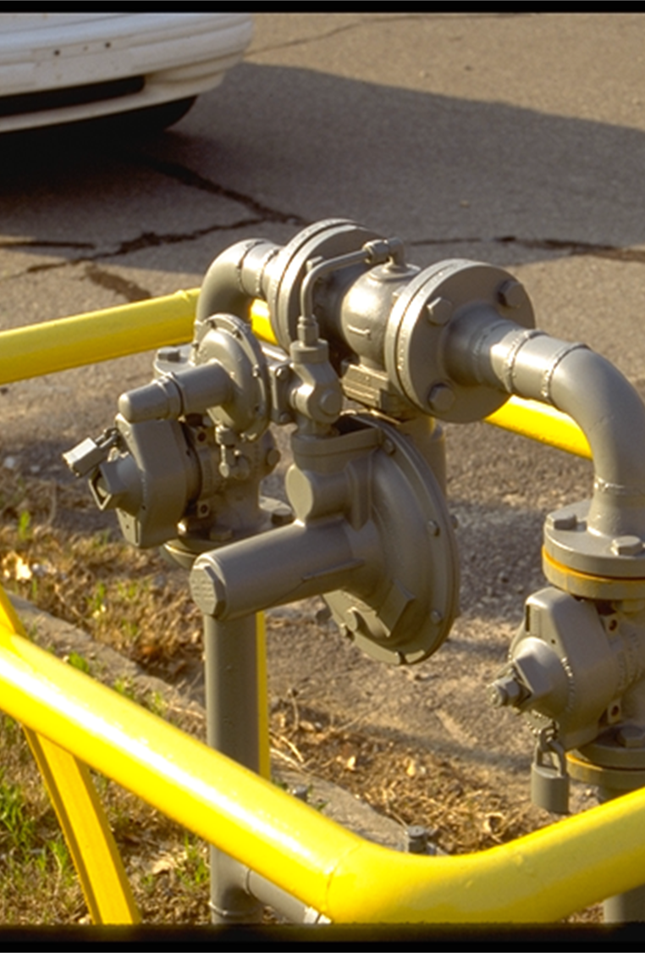
Other Documents
PHMSA interpretations, Alert Notices, Advisory Bulletins, special permits and enforcement documents
Memorandum of Understanding
  OSHA, FERC, USCG, EPA
Association standards
  NACE, ASTM, API, ASME, NFPA
Notes:
Changing gears now, Here are other documents that pertain to PHMSA and our mission. Operators must be aware of Interpretations which are operator specific questions sent in to PHMSA for a decision, Alert Notices and Advisory Bulletins which usually deal with weather or known hardware issues, Special permits or Waivers which are requested by the operator for certain situations such as a new material, and Enforcement documents which generally pertain to accidents (Liquid) or incidents (gas).
PHMSA has MOU’s or memorandum of understandings with multiple agencies listed on the slide. For instance, PHMSA has an MOU with the EPA for Unusually Sensitive Areas for liquids and an MOU with OSHA in regards to Gas to require respirators in gaseous atmospheres.
And the last part here we have already discussed standards that are incorporated by reference.

Slide 22
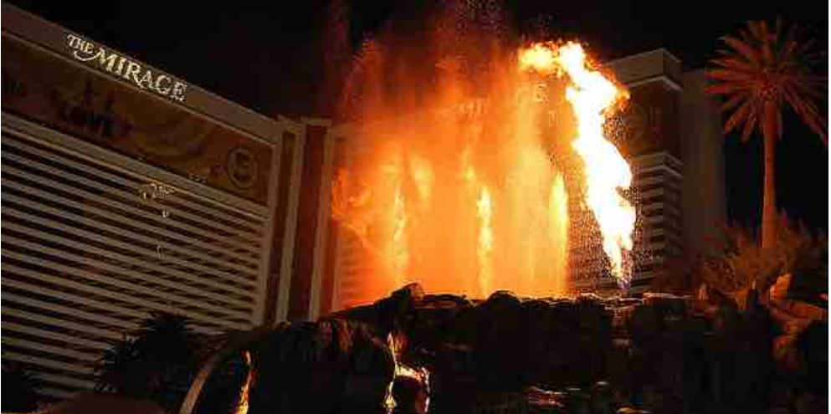
Special Permits
A special permit is an order that waives or modifies compliance with a regulatory requirement.
A special permit may be granted if PHMSA determines that it would be consistent with pipeline safety and the pipeline operator requesting it demonstrates the need.
A grant of a special permit is typically conditioned on performance of alternative measures that will provide an equal or greater level of safety.
If an operator has been granted a special permit, they may not have to comply with certain code requirements; however, they may have to implement more stringent efforts for the permitted area.

Slide 23
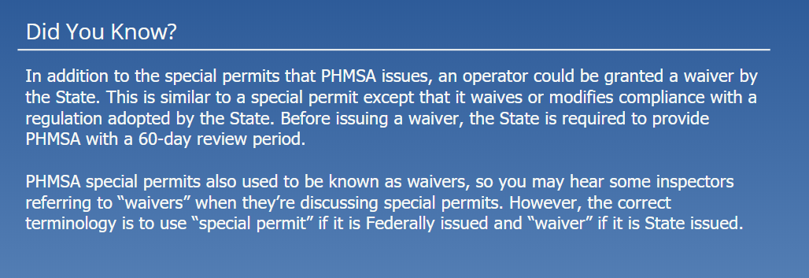
Waivers

Slide 24
Types of Rules
Legislative
  Rules that implement a statute.
Non-legislative
  Rules are often referred to as “guidance.”
Interpretive Rules
  These tell the public what the agency thinks the statute and the rules the agency administers mean.
Notes:
Basically Legislative rules are the actual rules themselves. They state specifically the way the rule shall be enforced, where as Non-legislative rules are more of a guidance as to “how” to follow the rule. While interpretive rules define the intent of a specific section of the rule.

Slide 25
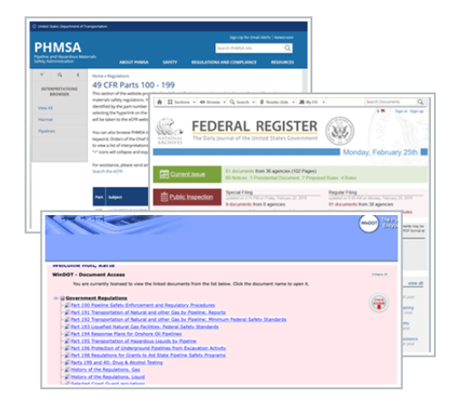
Interpretations
Where Interpretations can be found
PHMSA Website
Federal Register
WinDOT – subscription is required

Slide 26
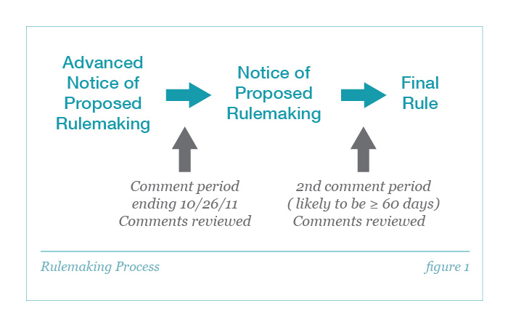
Rulemaking Process
Accidents are the reason behind many new rules.
Between each period of the process there is a 60-day comment period prior to the next step in the process even after the Final Rule.
Keep in mind PHMSA can’t always follow this order. There have been times where the rule is a congressional mandate. Example: Underground Storage Ruling

Slide 27

Federal Register
Not official until posted to Federal Register
Notes:
Notices of Proposed Rule makings for Liquid, Gas, or Hazardous Material Transportation can be found on the Federal Register or the PHMSA website; however the most up to date is the federal register and the PHMSA website can be somewhat behind compared to that. Therefore, if you are trying to look up a rule that just went through the NPRM process it is always best to reference the Federal Register.

Slide 28
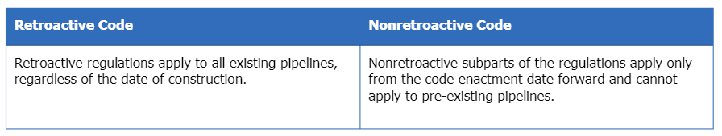
Retroactive code vs Nonretroactive Code

Slide 29
Nonretroactive code
When an operator is inspected, the inspector will apply the regulation for pipe design and construction that were in place when the pipeline was installed.
If changes are made to the pipeline, then current regulations will apply to the components that were changed.

Slide 30
Retroactive
  When a retroactive regulations go into affect it impacts all existing pipelines, regardless of the date of construction.
  This also includes Operator Qualification, Integrity Management and Control Room Management.
Notes:
When a retroactive regulation goes into affect it impacts all existing pipelines, regardless of the date of construction,
And operations and maintenance of pipeline facilities
This also includes operator qualification, Integrity management and control room management.

Slide 31
Part 192 Retroactive Subparts
KIL-A-MOP
Notes:
CFR 49 Part 192 has 7 retroactive subparts to include K is uprating, I is corrosion, L is operations, A is general, M is Maintenance, O is Gas Transmission Integrity Management and P is Distribution Integrity Management. One of the clever acronyms we use to help train inspectors is KIL-A-MOP.

