Slide 1
Protecting Your Company from an Over-Pressure Event

Slide 2
Merrimack Valley Incident – September 13, 2018
Pipeline replacement program to replace aging cast-iron low pressure system
System fed by 14 regulator stations reducing pressure from 75 psig to 0.5 psig
When tying over one of the regulator stations to the new main, the abandoned main still had the regulator sensing lines tied to it
Detecting pressures lower than set point, the regulators opened fully, delivering 75 psig into the low-pressure system
Pressure monitoring was in place on newly replaced system, but there was no ability to remotely control
By the time responders arrived and shut down the station, damage to 131 structures, several explosions, injuries and a death had occurred
8,600 customers lost service

Slide 3
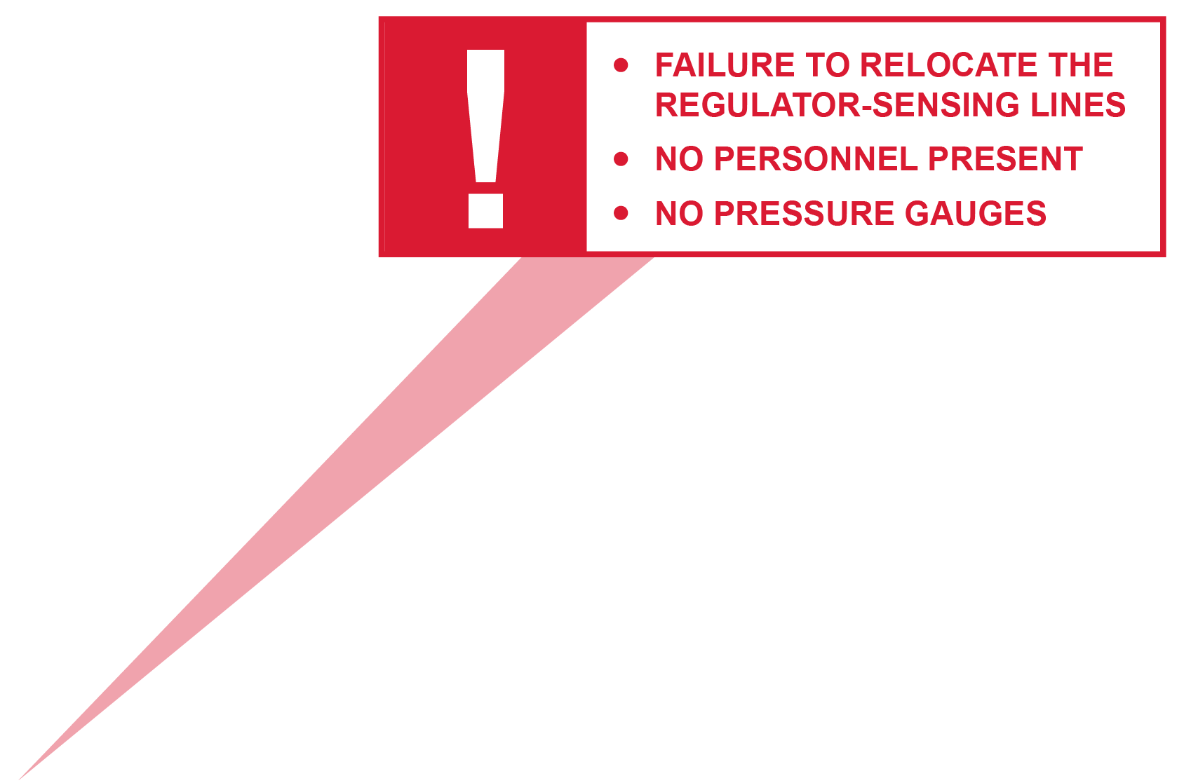
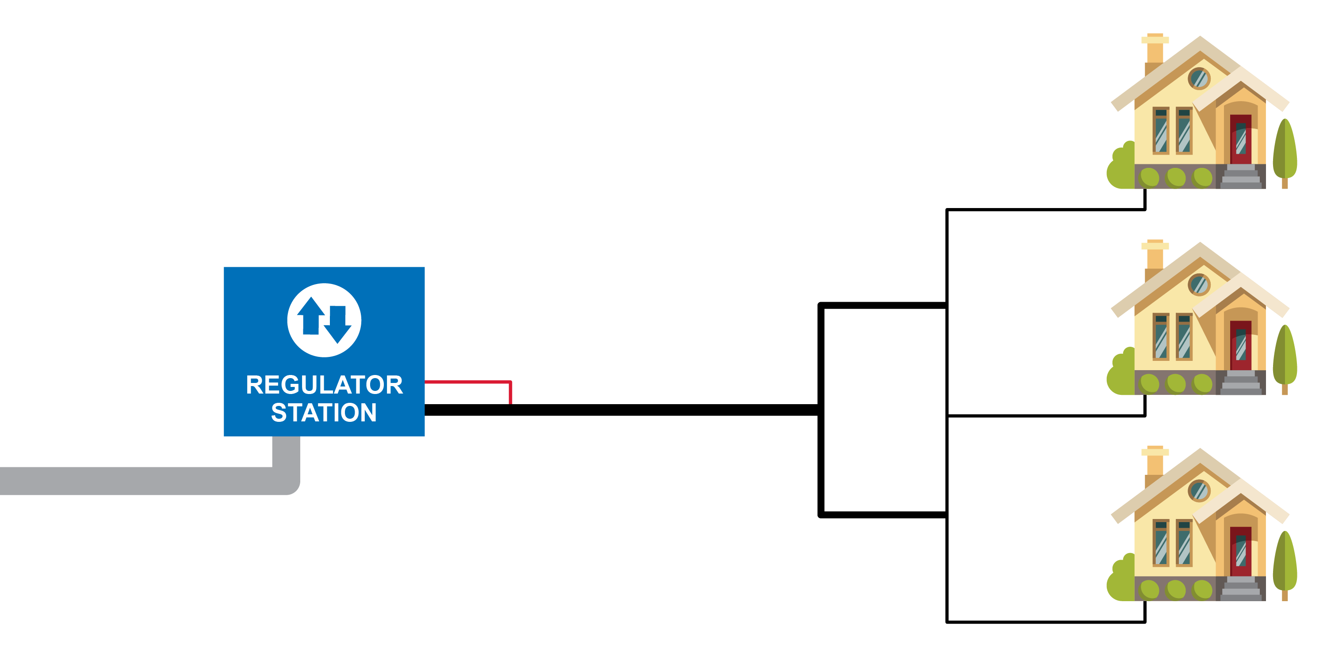
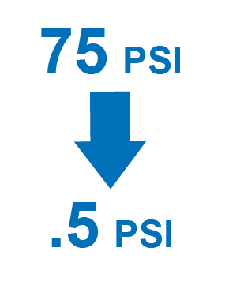
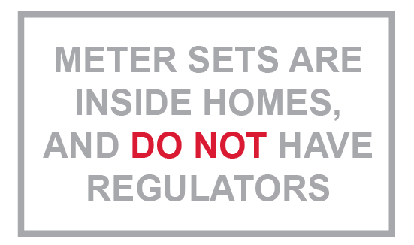
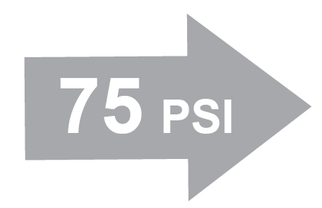
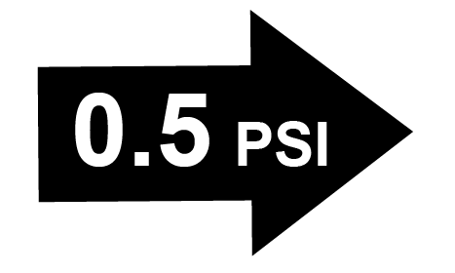
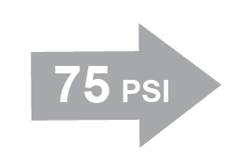
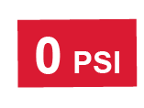
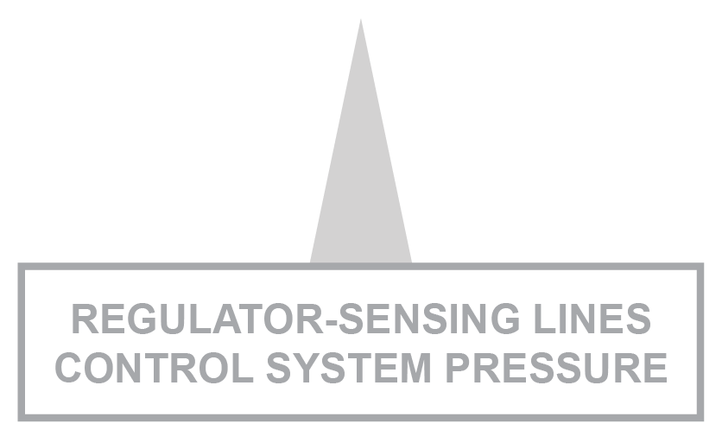
How did this happen?
Columbia Gas low-pressure system (at incident location)

Slide 4
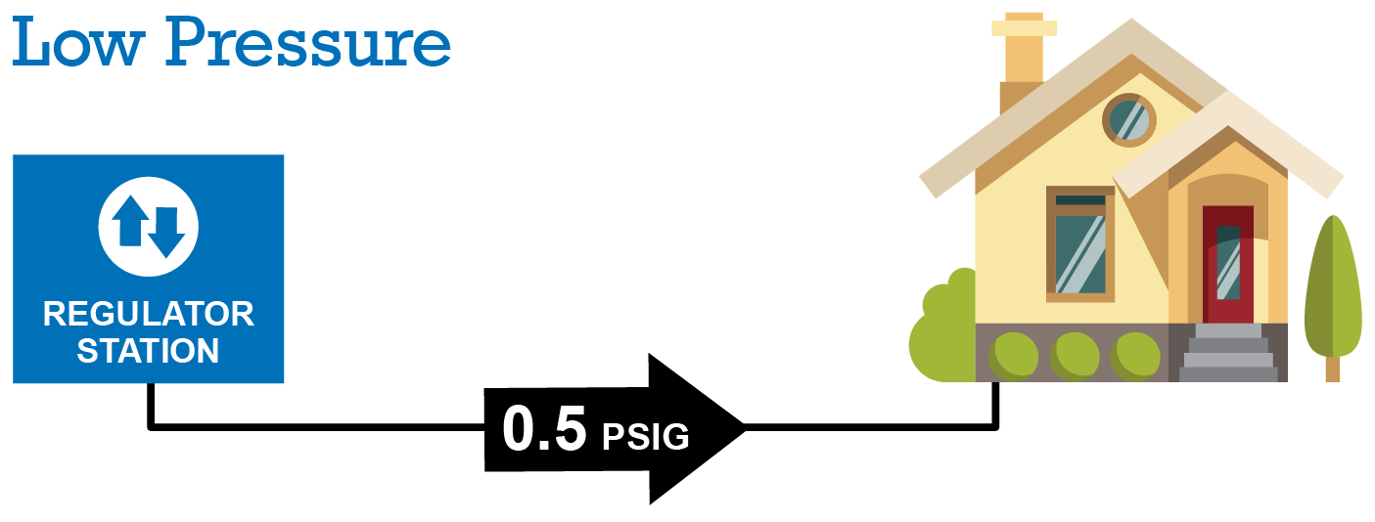

Slide 5
Findings
The location of the regulator sensing lines were not identified in the constructability review of the project, nor was much consideration given to the impact of the project on pressure regulation and control
Records of the sense line locations were not included in the work package; therefore, their relocation was not specified as part of the work process
No formal Management of Change (MOC) was conducted to analyze the risks and appropriate counter-measures of the project

Slide 6
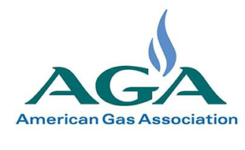
As a Result…
NTSB
Five urgent recommendations to the State of Massachusetts and NiSource, Inc.
AGA
Publishes “Leading Practices to Reduce the Possibility of a Natural Gas Over-Pressurization Event”

Slide 7
Response
Companies employ both procedural and physical safeguards for abnormal operating conditions like an over-pressure event
What are your potential sources of over-pressure?
What procedures/equipment do you have in place to protect against over-pressure?
Are there any gaps or room for improvement?

Slide 8
NTSB Recommendations
Ensure adequate Subject Matter Expert (SME) review of engineered drawings.
Evaluate current or implement comprehensive review process for construction, commissioning and take-down plans.
Review records management system to ensure all records are accurate, reliable and complete, particularly as they relate to pressure control and over-pressure protection.
Implement an MOC process to present, analyze and propose countermeasures to project risks.
Develop control procedures to safely execute changes approved through the MOC process including pressure monitoring points and critical personnel.

Slide 9
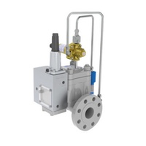
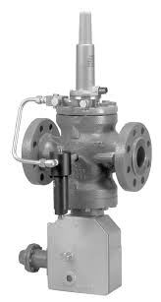
Other Recommendations
Standardization of regulator station and meter set designs
Tertiary over-pressure protection (slam-shut or full relief with standby-monitor configuration)
Increased pressure monitoring (telemetry)
Security of facilities – prevent vandalism AND operator error
Increased training and awareness for operators and contractors
Incorporate over-pressure into your DIMP/TIMP plan

